Slide 2
Jewish Messianic expectation
"Now while the people were in a state of expectation and all were wondering in their hearts about John, as to whether he was the Christ, John answered and said to them all, “As for me, I baptize you with water; but One is coming who is mightier than I, and I am not fit to untie the thong of His sandals; He will baptize you with the Holy Spirit and fire." (Luke 3:15–16)

Slide 3
Jewish Messianic expectation
"And he confessed and did not deny, but confessed, “I am not the Christ.” They asked him, “What then? Are you Elijah?” And he said, “I am not.” “Are you the Prophet?” And he answered, “No.” Then they said to him, “Who are you, so that we may give an answer to those who sent us? What do you say about yourself?” "They asked him, and said to him, “Why then are you baptizing, if you are not the Christ, nor Elijah, nor the Prophet?” (John 1:20–22,25)

Slide 4
Jewish Messianic expectation: what they got right
Dead Sea Scrolls: 11QMelchizekek; 4Q174-4QFlorilegium; 4Q175-4QTestimonia
KING WITH SCEPTER AND PRIEST AS STAR: Num 24:15-17; Isa 9:6-7; Zech 6:12-13; Heb 1:8;
Matthew 2:2; Rev 22:16
BRANCH OF DAVID: Isa 11:1-5; Isa 53:2; Jer 23:5-6; Zech 6:12-13; Mt 2:23
A LAWGIVER PROPHET LIKE MOSES: Deut 18:18-19; Jer 31:31; Acts 3:22; 7:37; Jn 17:7-8;
Col 2:14; Heb 7:11-12; 8:13; 9:15; 1 Cor 9:21; Gal 6:2
RIGHTEOUS/PERFECT INTERPRETER OF THE LAW: Dan 12:10; Eze 37:23; Ps 2:1;Acts 4:25-27
RESTORE THE TEMPLE OF DAVID: 2 Sam 7:10-14; Amos 9:11/Acts 15:16; Jn 2:19-22;
Mt 26:61; 27:40; Mk 14:58; Acts 6:14; Eph 1:21-22; 2:19-22
HEAVENLY BEING: Melchizedek was the “messianic heavenly being”: DSS: 11QMelchizedek

Slide 5
Mistaken Jewish Messianic expectation:
(what the Jews got wrong)
TWO MESSIANIC MEN not one: two messianic figures: “Star” High priest + “Scepter king”
Balaam prophecy Num 24:17; Zech 6:12-13.
PHYSICAL WARRIOR not spiritual: Warrior King against Rome: John 18:36–37
WARRIOR TO DEFEAT ISRAEL'S ENEMIES: Num 24:17; Deut 33:11; Psalm 89:23; Heb 1:3; Jn 18:36; Rev 17:14
ABOMINATION OF DESOLATION punishment from God, not persecution from Satan
NOT AARONIC HIGH PRIEST: expected the “priest Messiah” from Zadokite priesthood: (Florilegium: Dead Sea Scroll 4Q174, line 17, 90 BC)
The Jews never understood at that the Messiah would be OPPOSED to the priesthood and working against it, not working in harmony and under its direction: Mt 23
NOT MELCHIZEDEK HIMSELF but a type of Melchizedek (book of Hebrews 3,4)

Slide 7
“I came across a man who had in hand a scroll, written in Assyrian [block] letters in the holy language. “I said to him, ‘Where did you get this?’ “He said to me, ‘I was employed in the Roman armies, and I found it in the Roman archives.’ “In the scroll it is written that after four thousand two hundred ninety-two {4292} years from the creation of the world, the world will be an orphan. “[As to the years to follow] in some there will be wars of the great dragons, and in some, wars of Gog and Magog, and the rest will be the days of the Messiah {ie. 4292 – 6000 years from creation}. “And the Holy One, blessed be he, will renew his world only after seven thousand years.” (Babylonian Talmud, b. Sanh. 11:1, I.88.A–91.F)

Slide 8
“Said R. Qattina, “The world will exist for six thousand years and be destroyed after one thousand (B. Tal, Sanh. 11:1)

Slide 10
“Time if fulfilled, the
kingdom of God is
at hand” (Mk 1:15)
“The people were
in a state of
expectation” (Lk 3:15)

Slide 11
The New Testament references this Jewish eschatological “Days of Messiah” terminology:
"So when they had come together, they were asking Him, saying, “Lord, is it at this time You are restoring the kingdom to Israel?”" (Acts 1:6)
Peter in his second sermon said, “Therefore repent and return, so that your sins may be wiped away, in order that times of refreshing may come from the presence of the Lord; and that He may send Jesus, the Messiah appointed for you" (Acts 3:19-20).
Paul said that “all spiritual blessings are in the Messiah” (Eph 1:3).
REVELATION chapter 20

Slide 13
List of Jewish false messiahs
Alexander Jannaeus (103-76 BC) “messianic star” (Number 24:17); king/priest coin (Zech 6:12)
Antigonus II (40-37 BC) king/priest coin echoing Zech 6:12
Theudas <2 BC: Acts 5:36-37
Judas the Galilean 2 BC - 6 AD: founded zealot movement: Acts 5:36–37 (Josephus Antiquities 20.102–103)
Judas the Galilean 2 BC - 6 AD: (Josephus Antiquities 18.4–10)
Judas the Galilean 6-9 AD: (Josephus Wars 2.117–118)
Theudas the Magician 44-46 AD, parted the Jordan river in (J. Ant. 20.97)
Simon Bar Kokhba in 132-125 AD: “Son of Star” to “son of the lie”
Muhammad in 629 AD: (Chronicle of Theophanes Confessor 813 AD)
Menachem Mendel Schneerson (1902-1994) Lubovich Movement.

Slide 14
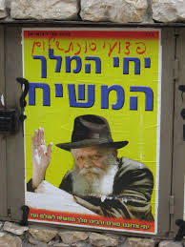
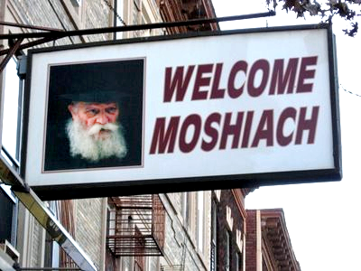
Menachem Mendel Schneerson
(1902-1994)
Chabad/Lubavitch Movement

Slide 17
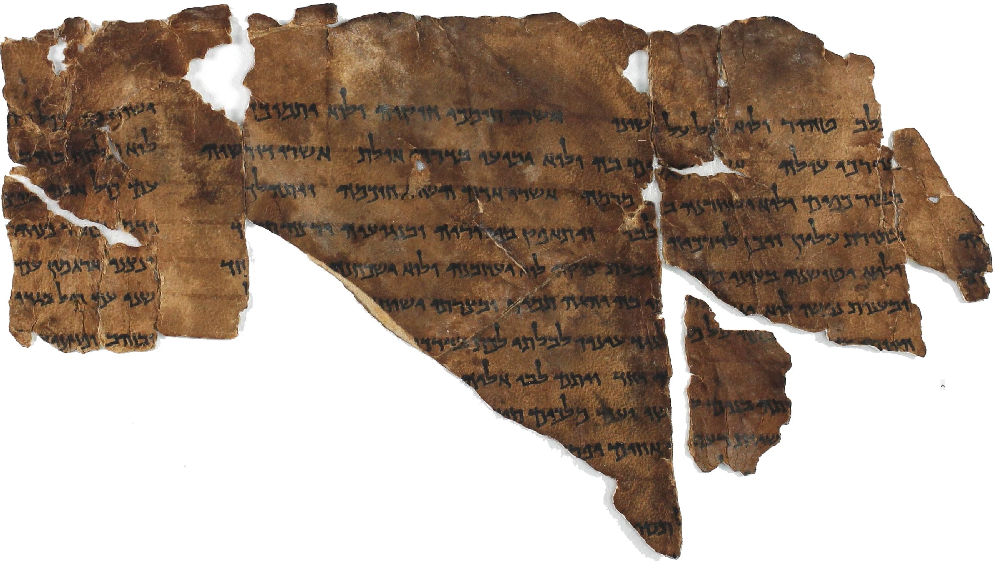
“Melchizedek” dead Sea Scroll: 90 BC: 11QMelchizekek
“Although 1QapGen 22:14–17 retells the story of Melchizedek
without elaboration, in 11QMelchizedek,
Melchizedek ceases to be an earthly figure.
He rather becomes an angel called “the heavenly one”
and he is a central figure in the eschatological drama.
At the end of days he proclaims release to the captives
(11QMelch. 2:6; cf. Lev 25:10), exacts
“the vengeance of the judgements of God” (11QMelch 2:13)
and delivers the sons of light from Belial (11QMelch 2:13).”
(Dictionary of the later New Testament and its developments, Melchizedek, p 729, 1997 AD)
The Book of Hebrews validates the connection between Jesus of Nazareth and Melchizedek

Slide 19
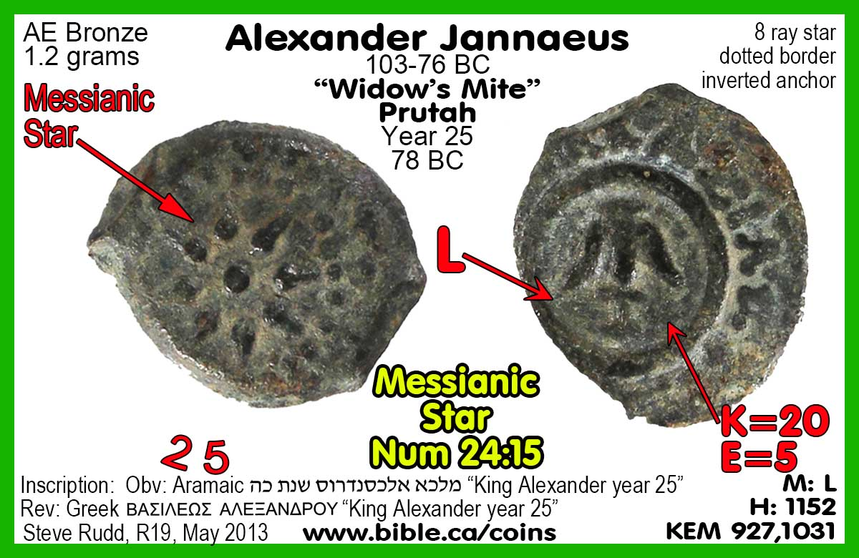
14 of these coins excavated in 2017 at Shiloh.
Messianic Star: Num 24:17 (fulfilled in Star of Bethlehem) DSS: 4QTestimonia
The smallest and most common coin featured a messianic star from Balaam’s prophecy. Jannaeus clearly invoked messiah-like symbolism for himself given he enjoyed independence from Rome 103-76 BC. (fulfilled in Star of Bethlehem)

Slide 23
Star, Priest, King, branch temple builder: Zech 6:12-13
4QTestimonia
This special issue “widows Mite” features triple messianic imagery of priest-King, branch, temple restorer. “King-Priest” are spelled in long extinct Paleo-Hebrew in between the rays of the star creating a triple messianic connection with “Of King Alexander” on the flip side, implying that Jannaeus himself was the messiah.

Slide 25
Priest-King: Zech 6:12-13 4QTestimonia
While others minted a coins with either King or Priest on them, Antigonus II was the only other Hasmonean to mint a single coin with both priest and king on it. With Herod’s rebuilt of the temple in 18 BC, perhaps the Jewish temple was run down and in need of repair like in the time of Josiah. This encouraged their role as temple restorers.

Slide 27
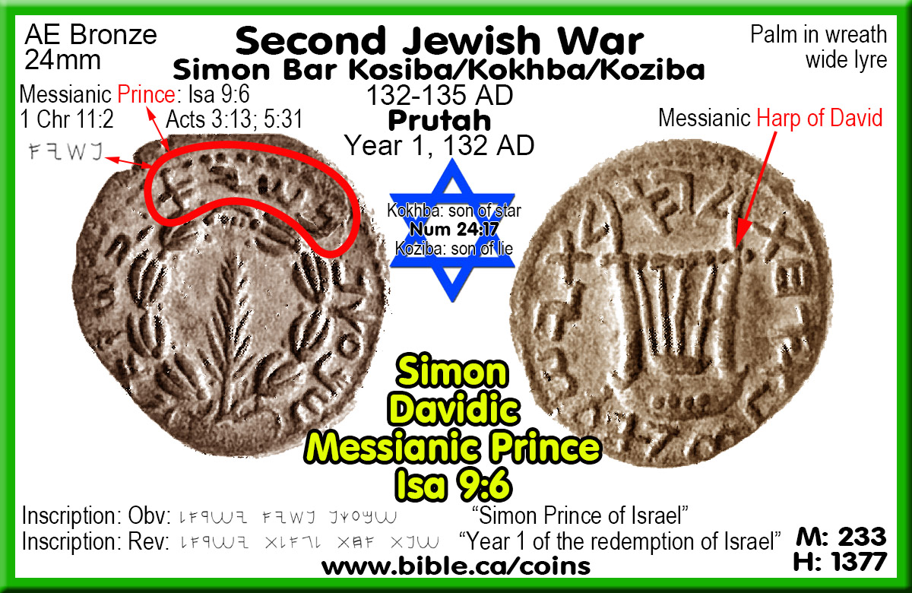
Prince: Isa 9:6
If the Hasmonean’s hinted quietly they were the messiah, Simon Bar Kokhba removed all doubt he was the messiah as clearly seen in his coins. In year one Simon Christ applied the “prince” of Isa 9:6 messianic prophecy to himself and indeed he ran the government and defeated Israel’s enemies (Rome) for three years.
“Simon bar Kosiba, President/Prince over Israel, to Yehonathan and Masabala, peace. [My order is] that you search and seize the wheat which is in the possession of Hanun” (Bar Kokhba's Letters, The Wooden Letter)

Slide 29
Restored temple: Amos 9:11; 2 Sam 7:14 4QFlorilegium
With Simon’s successes in year one, his “year two of freedom of Israel” coins with the messianic star above the restored Jerusalem temple represent the peak of his power. He was now boldly claiming to be the Messiah of prophecy and a large majority of the Jews believed his claim that the “Days of the Messiah” had begun!

Slide 31
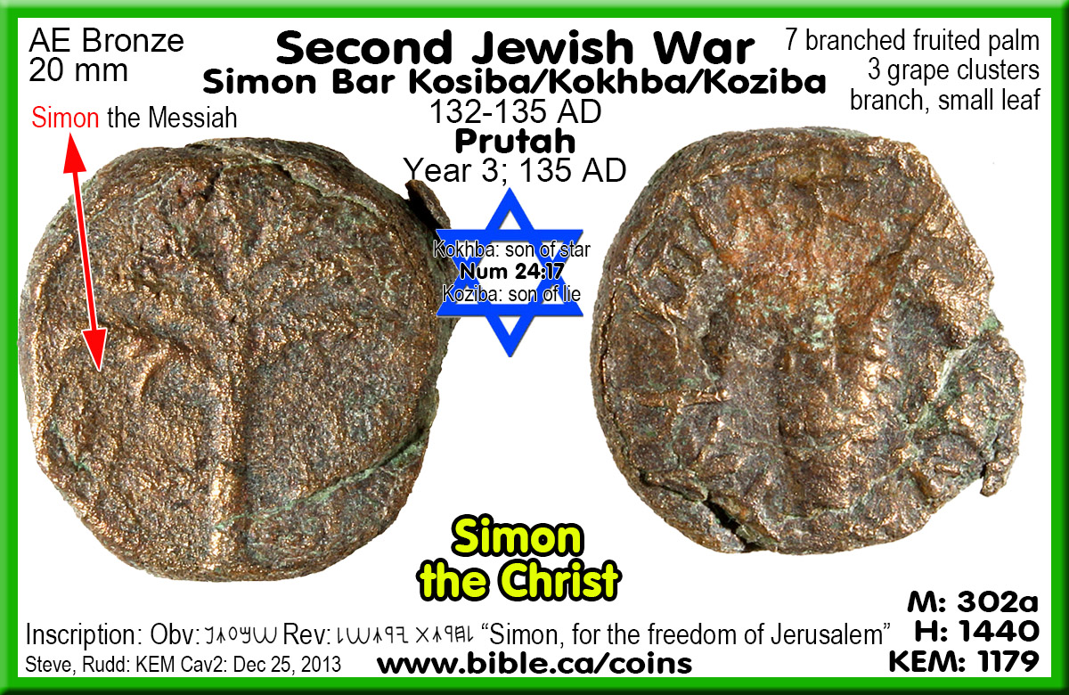
Simon the Christ “Son of the Star” became “son of the Lie” after his defeat.
This year three coin has “Simon” on the obverse and “for the freedom of Jerusalem” on the reverse. The substitution of freedom of “Israel” for “Jerusalem” focused the need to restore the Temple destroyed in 70 AD. Simon, known as “son of the Star” was called “son of the Lie” after a massive slaughter in 135 AD by Hadrian who erected a temple of Jupiter on the temple mount.

Slide 33
Messianic Harp of David
It is universally accepted that Simon Bar Kokhba claimed to be the messiah, branch of David. Hendin 1389, 1424, 1429 are very similar with Simon on obverse and three string harp/lyre of David on reverse.

Slide 35
Messianic Harp of David
This coin has Simon’s name AROUND the Davidic harp is a bold announcement the messianic branch/son of David who fulfills prophecies. Hendin 1436

Slide 37
Dual Messiahs: John 1:20-22
Witnessed in 4QFlorilegium: 2 Sam 7:12-14; Amos 9:11
TWO MESSIAHS: Dead Sea scroll 4QFlorilegium documents they also thought the messiah was two different men:
“This refers to the branch of David, who will arise with the Interpreter of the law who will rise up in Zion in the last days” (4QFlorilegium, explaining 2 Sam 7 & Amos 9:11). This false idea of twin messiahs is also seen in John 1:20-22. The Jews at the time of Jesus Christ misunderstood much of what the Messianic prophecy was really predicting. They never dreamed the land promise was heaven, the restored temple was the body of Christ, the kingdom was the church and that the messiah was the liberator over the devil not Rome. They were looking for two messiahs when only Jesus was predicted.

Slide 41
Steven Rudd Bible Coins: www.bible.ca/coins

