Slide 1
Date and Pharaoh of the Exodus from Christian Literary sources
The earliest Christians universally taught the early exodus date in the 15th century BC and identified a variety of Pharaohs from the early 18th Dynasty. The origin of the late date of the exodus at the time of Ramses II is pagan Egyptian and Roman historians.
Steven Rudd, Dallas, Thursday, November 18, 2021, ETS/NEAS

Slide 2
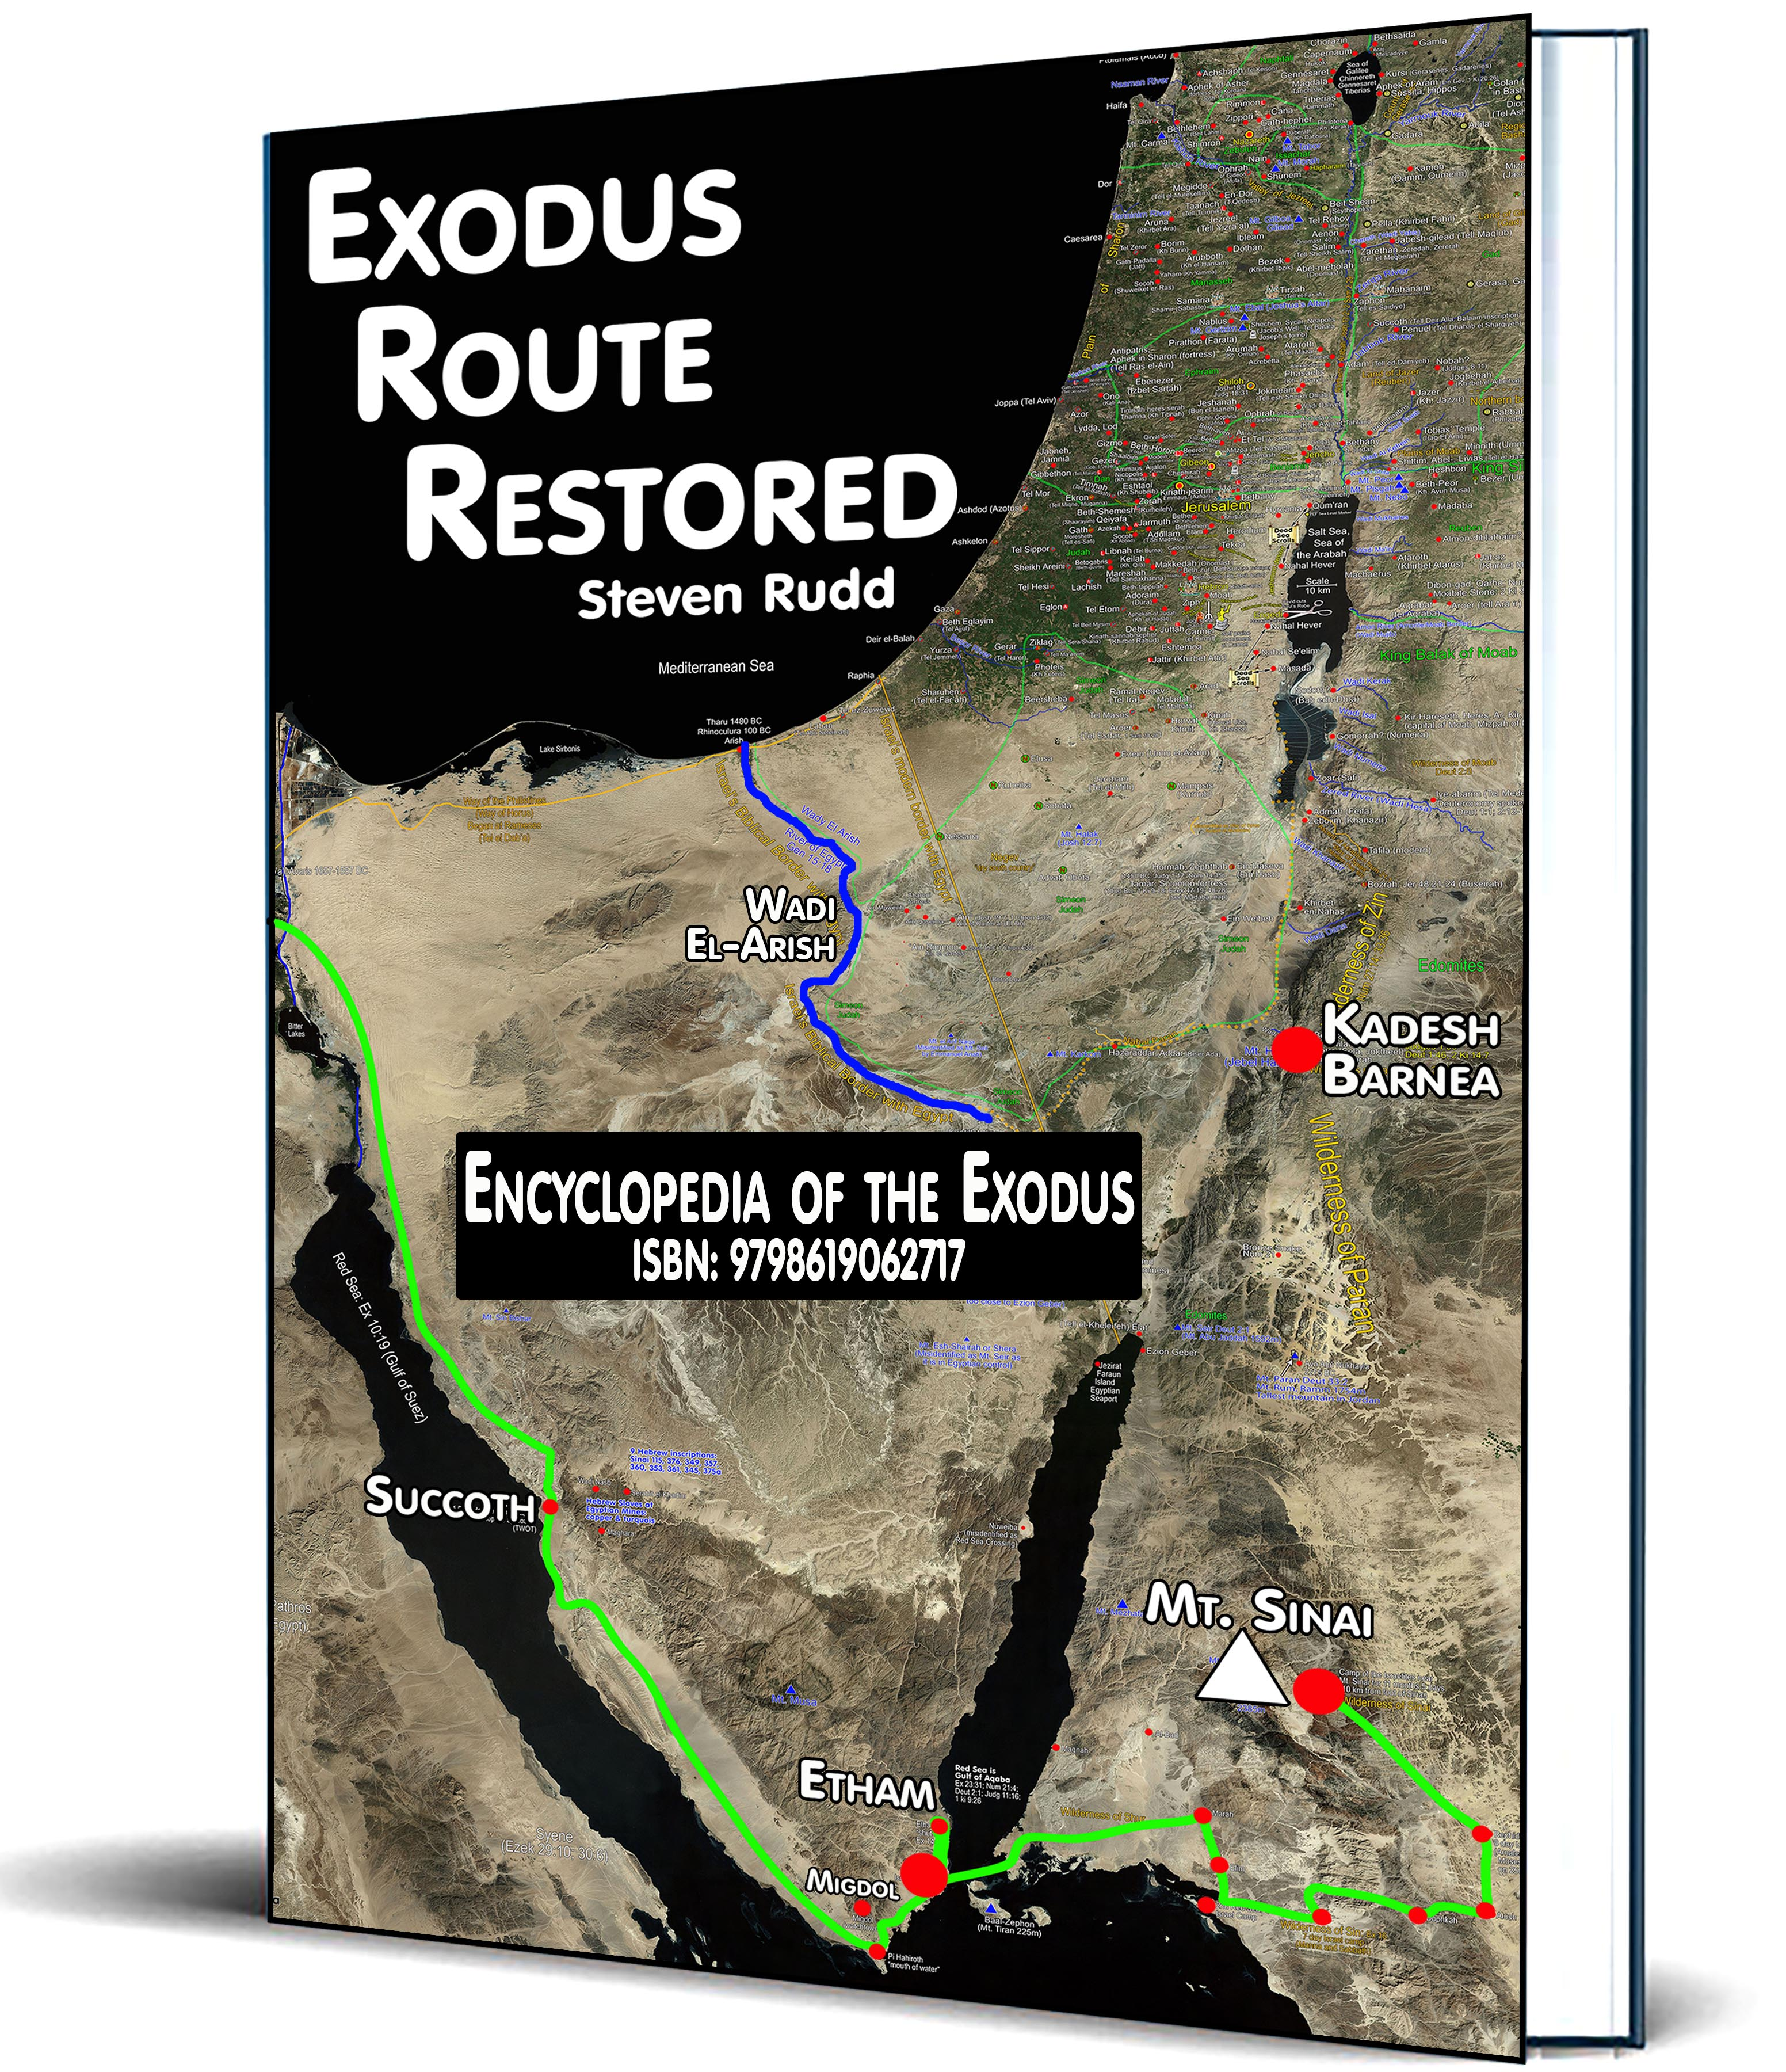
Date and Pharaoh of the exodus from 23 ancient Jewish, Pagan, and Christian literary sources
Steven Rudd
Dallas 2021
ETS/NEAS
PowerPoint: www.bible.ca/NEAS
Canada@bible.ca www.bible.ca/exodus
4 buying options
Paperback colour: 590 pages: $195 USD
Paperback B&W, 590 pages: $80 USD
Digital 590 pages: $10 USD
Online: Free

Slide 3
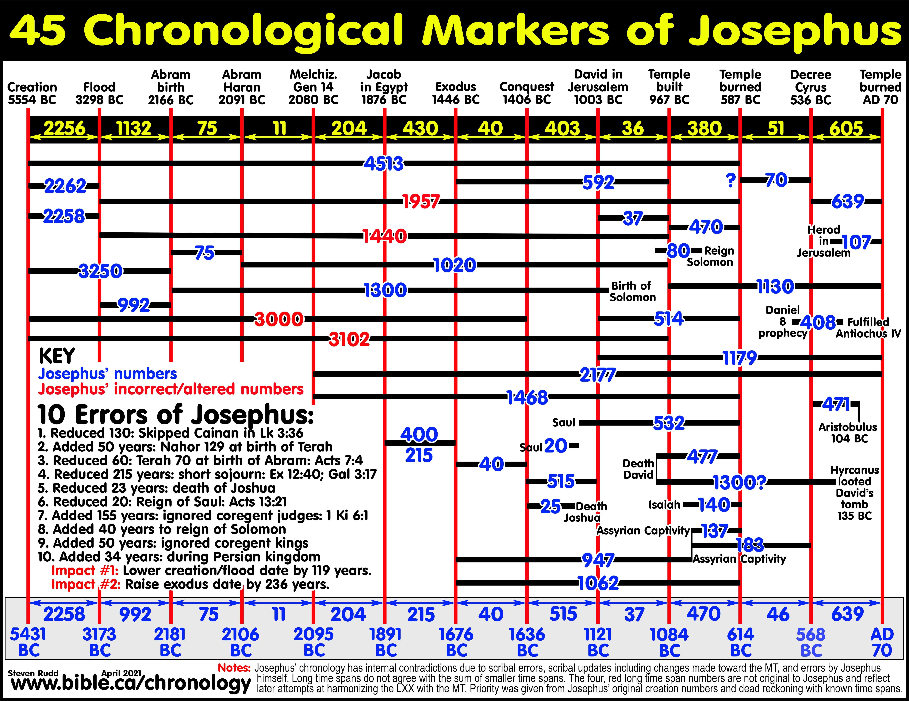

Slide 4
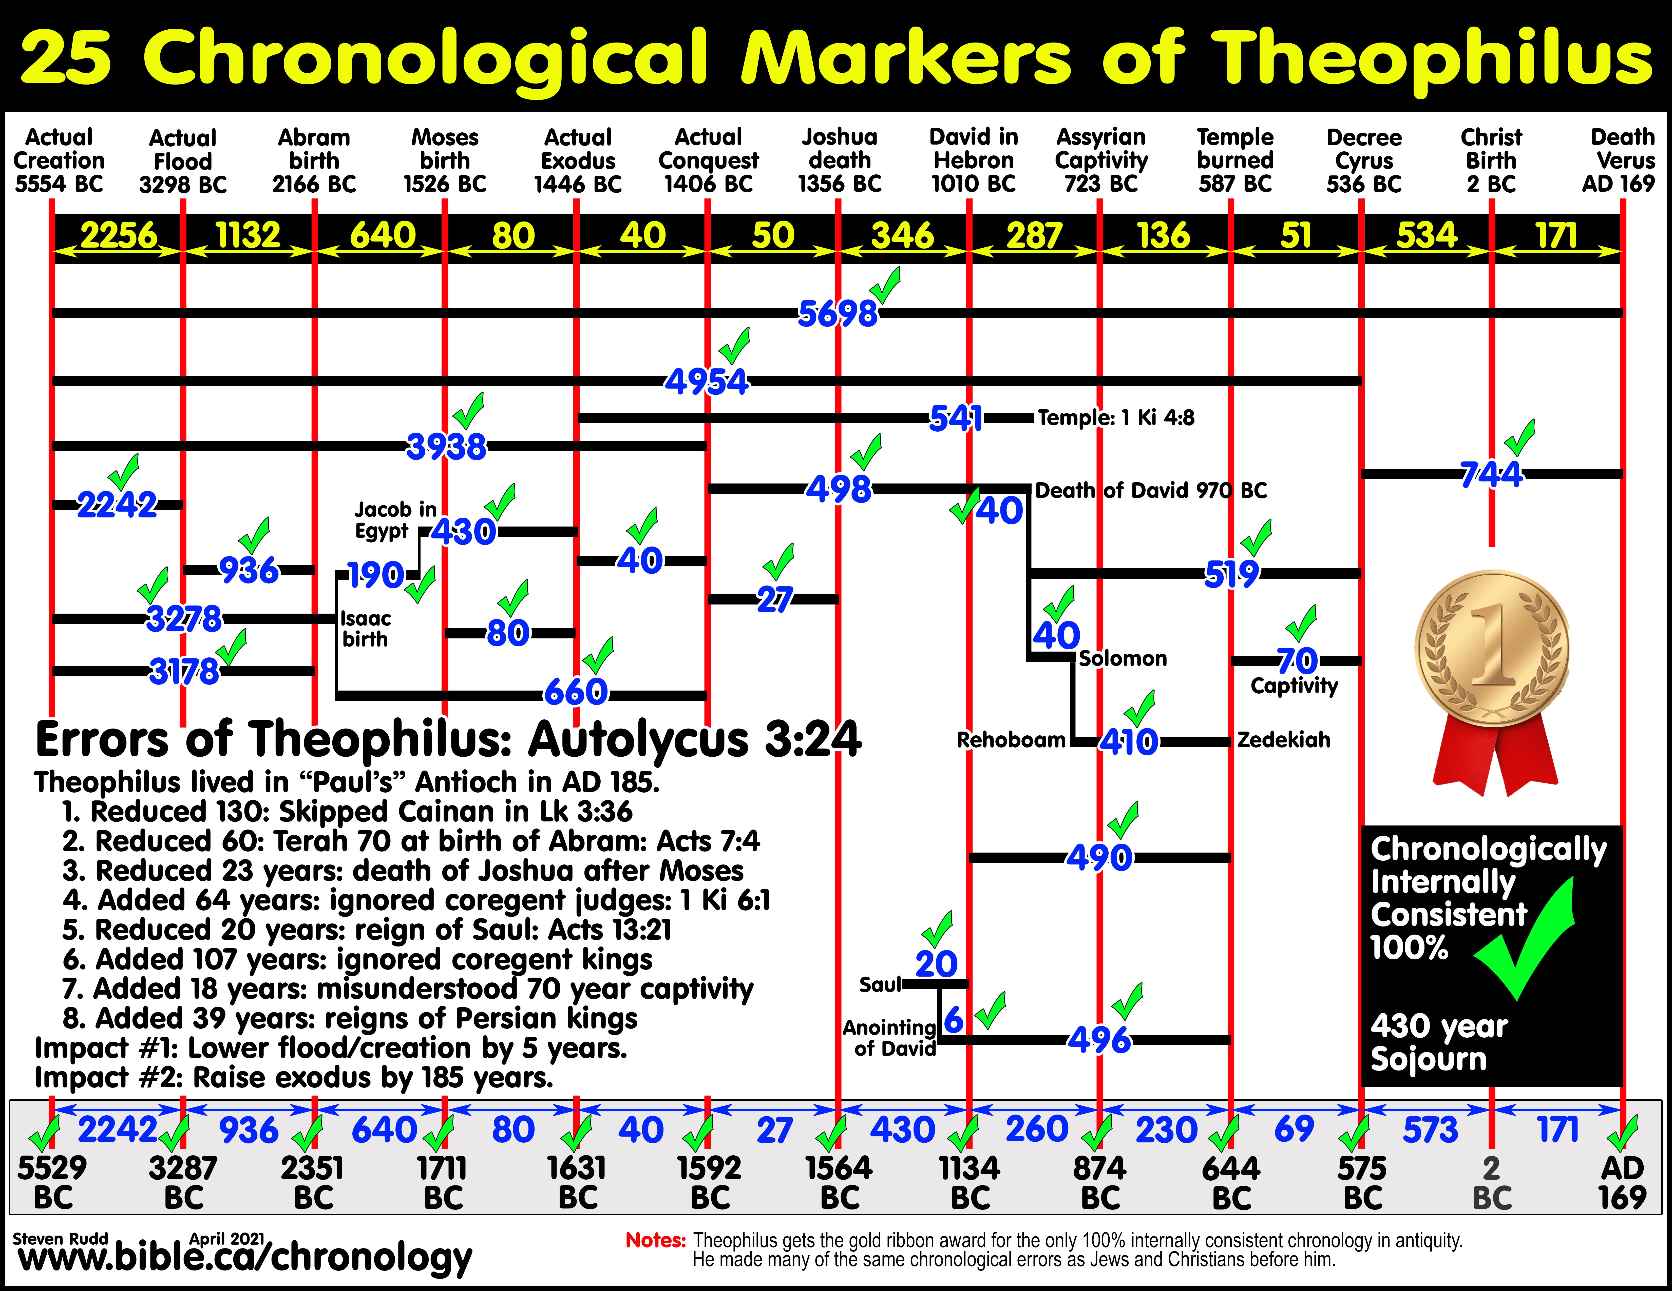

Slide 5
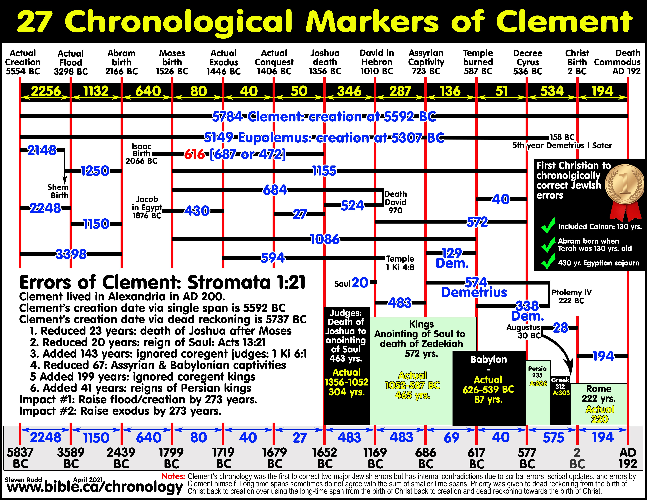

Slide 6
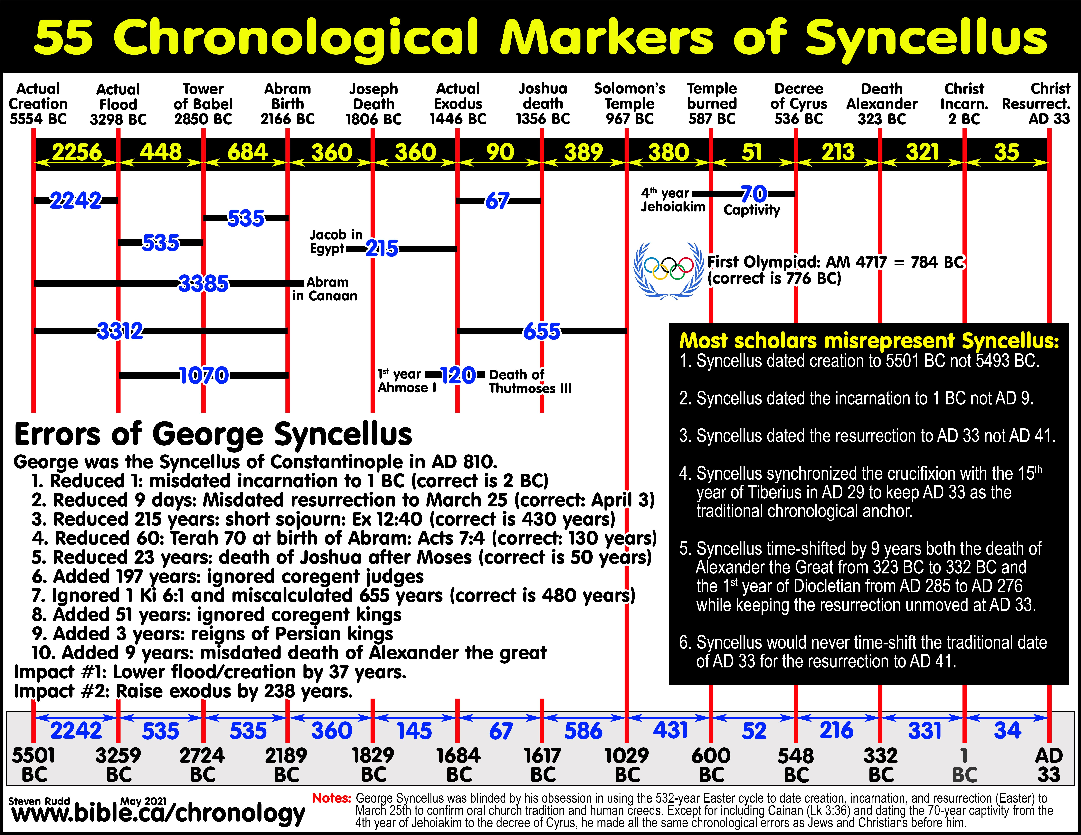

Slide 7

Summary of 8 major chronological errors
Persian: added 40 years: Cause: bad historical records
Divided Kingdom: added 50-200 years: Cause: misunderstood coregencies of kings
Exodus to Solomon’s temple: added 50-200 years. Cause: ignored 480 years of 1 Ki 4:8 and misunderstood coregencies of Judges
The Holy Spirit corrected 5 errors in the New Testament
Miscalculated the death of Joshua after crossing the Jordan to 23 years
(Corrected in New Testament to 50 years: Joshua was type of Sabbath
rest in Hebrews 4:8. Died after first 49-year Jubilee after crossing Jordan)
Used short sojourn of 215 years in Egypt (Corrected in New Testament to 430 years:
Ex 12:40; Gal 3:17)
Misdated Terah as 70 years old when Abraham was born (Corrected in New Testament to 130 years: Acts 7:4).
Saul reigned only 20 years. (Corrected in New Testament to 40 years: Acts 13:21)
Skipped the 130 years of Kainan (Corrected in New Testament: Lk 3:36)

Slide 10
FOOTNOTES:
1: Assumed to be same as Josephus
2: Seder Olam counted 450 years for the period of the judges but calculated 480 years by counting only the
Hebrew Judges reigns (338 years) and ignoring the oppressor reigns (111 years). Eusebius calculated 480 years by
borrowing this delusional chronological solution from the Jews in Seder Olam.
3: Titian gave no date, but like others (Clement), synchronized with Inachus around 1700 BC in their
flawed chronologies.
4: Africanus dated the baptism of Jesus to AD 29 and calculated only a 1 year ministry of Christ for a
crucifixion in AD 30.
5: Hippolytus used a highly symbolic Midrashic hermeneutic in everything. He put a 500 year gap in the 70 weeks of
Daniel 9 beginning with the incarnation of Christ and ending in the second coming in AD 500 at the conclusion of
the last day of the final 3 ½ years. He believed the end came when the earth was 6000 year old.
6: Eusebius began the 70 weeks with the completion of the temple in the 6th year of Darius (515 BC) and ended the
69th week in 30 BC with the death of Hyrcanus. He inserted a 28 year gap between the 69th and 70th weeks. The
70th week began with the baptism of Jesus in AD 29 where the end of the first 3 ½ years coincided with the
crucifixion and the end of the second 3 ½ years coincided with AD 37. Eusebius’ 70 weeks was a total of 552
years: 515 BC – AD 37.
7: Annianus, Dionysius, and Syncellus dated creation, incarnation, and resurrection to March 25th.
Dionysius used a 1 year ministry of Christ with death in AD 30.

Slide 11
Summary chronological findings
Five pre-Christian Jewish Chronological errors corrected by the New Testament.
All ancient Jews and Christians favored the early date of the exodus (18th Dynasty) but all ancient pagans and Bible scoffers favored the late date of the exodus around the time of Ramses II in the 19th Dynasty. The same is true today.
First century Jews and Christians down to AD 200 widely believed a king named “Thutmoses” was the Pharaoh of the exodus synchronized with the first king of Manetho’s 18th Dynasty list, which we know today was Ahmoses I. It remains unsettled whether this association of the exodus Pharaoh with a Pharaoh named “Thutmoses” came from ancient Jewish oral and written tradition or from their analysis of Manetho’s Egyptian Chronology synchronized with their flawed Bible chronology. One explanation why the earliest Jews and Christians identified the Pharaoh of the exodus as the first king of the 18th Egyptian Dynasty is an oral and written tradition that associated the exodus with a Pharaoh named “Thutmoses”.
Birth and resurrection of Christ: Most early Christians dated the birth of Christ to 2 BC with a resurrection in AD 33.

Slide 12
Summary chronological findings
Dating the Tower of Babel: George Syncellus is the only ancient chronologer who ventured to date the Tower of Babel. His date for the division of languages of 2724 BC was only 125 years short of the correct 2850 BC.
70 weeks of Daniel 9: Most early Christians understood the 490 years of Daniel 9 as a continuous sequence of years without any gaps ending at the resurrection of Christ.
Manetho’s leper exodus Pharaoh whom he called “Amenophis” was identified with Merneptah, the son of Ramses II.
Creation and the age of the earth: Despite 10 common chronological errors, ancient Jews and Christians were remarkably close to correct for the age of the earth at 5554 BC. The hundreds of extra error years after the exodus almost perfectly canceled out the hundreds of deficit error years before the exodus. The result was the first century understanding by Josephus that the earth was about 5431 years old when Christ was born erred by only 123 years.
Greek Septuagint (LXX) not the Hebrew Masoretic Text (MT): Jewish Demetrius and every Christian chronologer used the longer numbers in Genesis 5 and 11 from the Septuagint not the corrupt numbers from the Masoretic text.

Slide 13
PowerPoint:
www.Bible.ca/NEAS
Steven Rudd
ETS/NEAS
Dallas, Nov 2021
4 buying options
Paperback colour: 590 pages: $195 USD
Paperback B&W, 590 pages: $80 USD
Digital 590 pages: $10 USD
Online: Free

