Slide 1
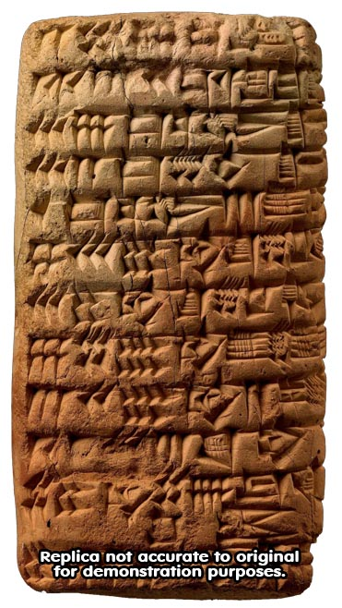
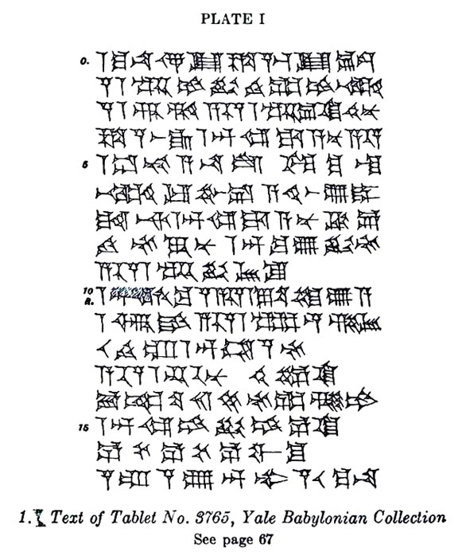
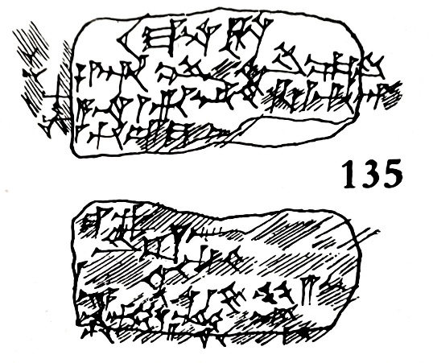
Archaeology of Daniel
“Belshazzar Chief Official of the King”
Steven Rudd
Near Eastern Archaeological Society Lectureship, San Deigo, 2024
Museum of Florence #135
Yale Babylonian Collection #3765
561 BC
560 BC

Slide 5
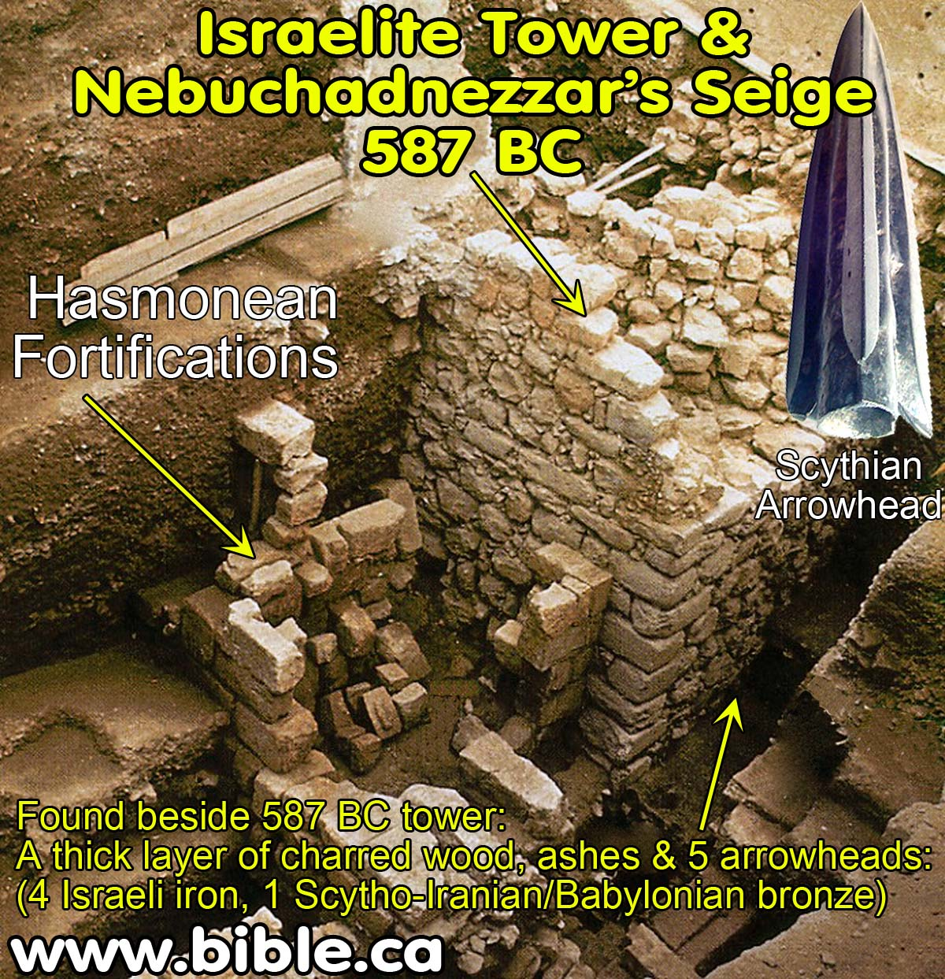

Slide 6
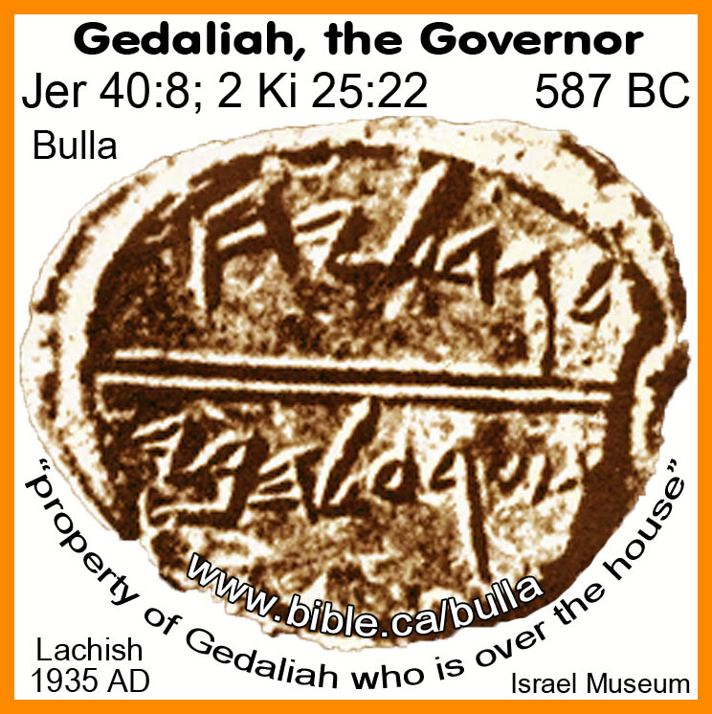

Slide 7
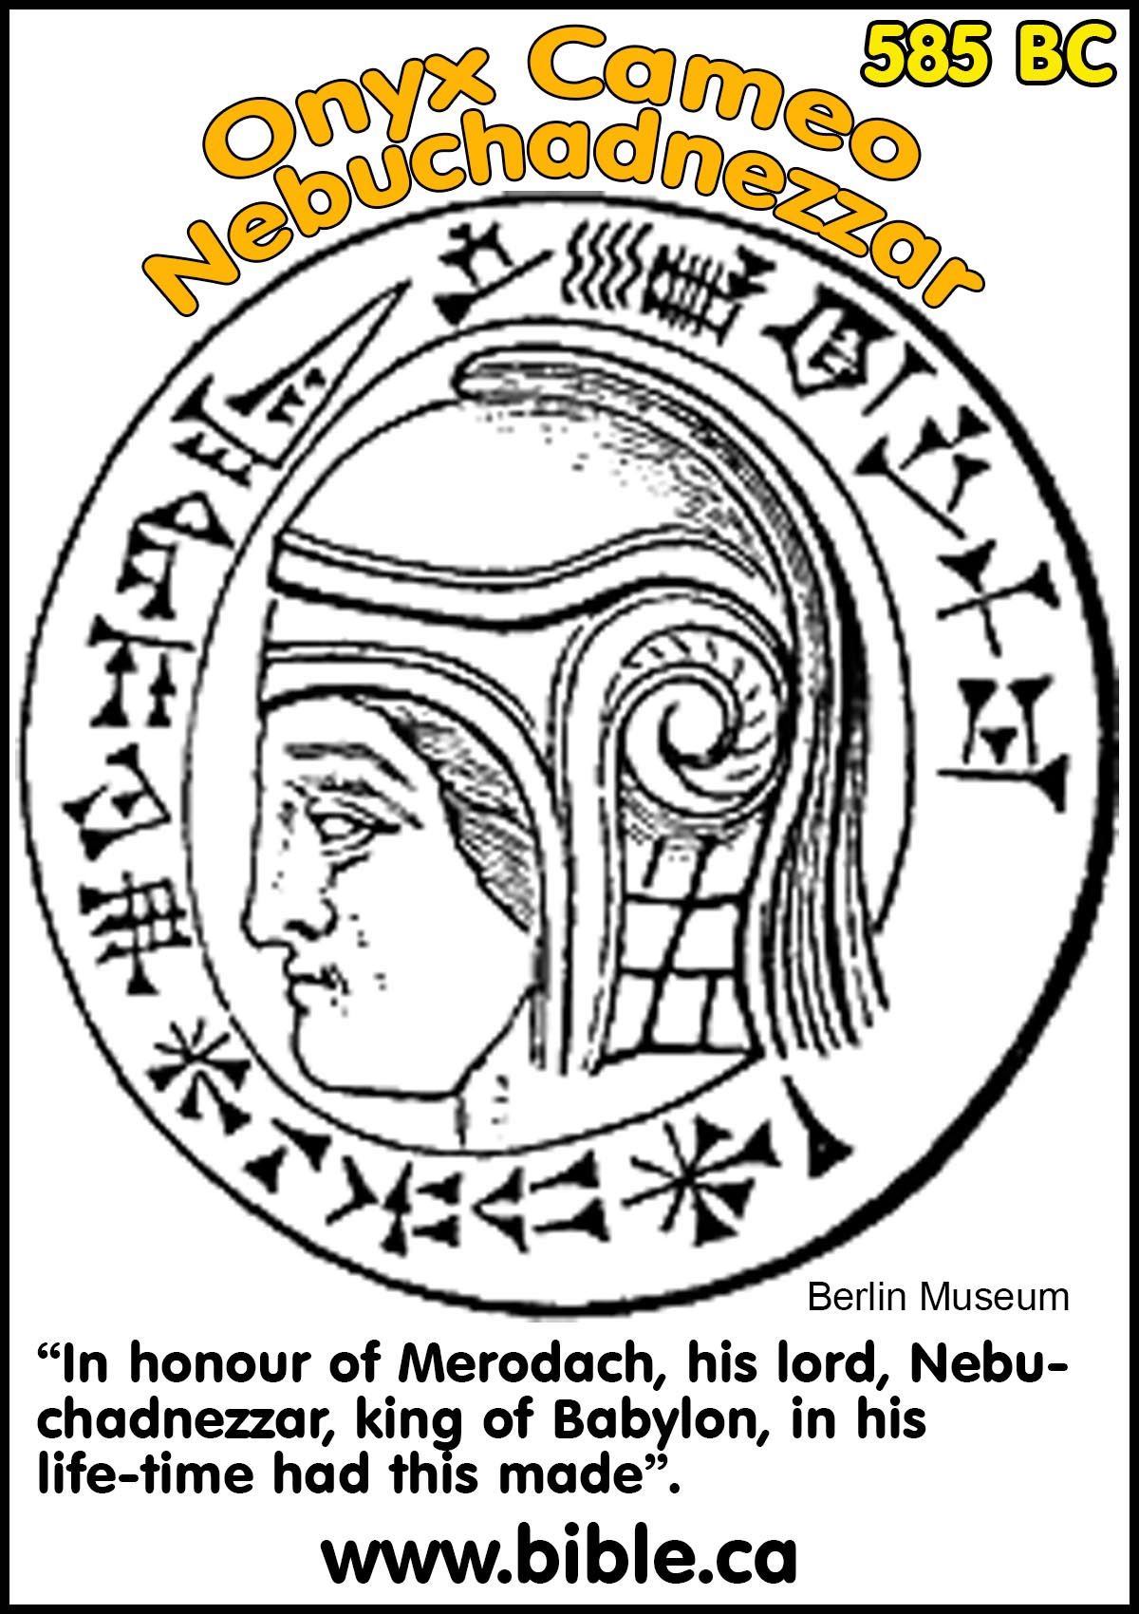

Slide 8
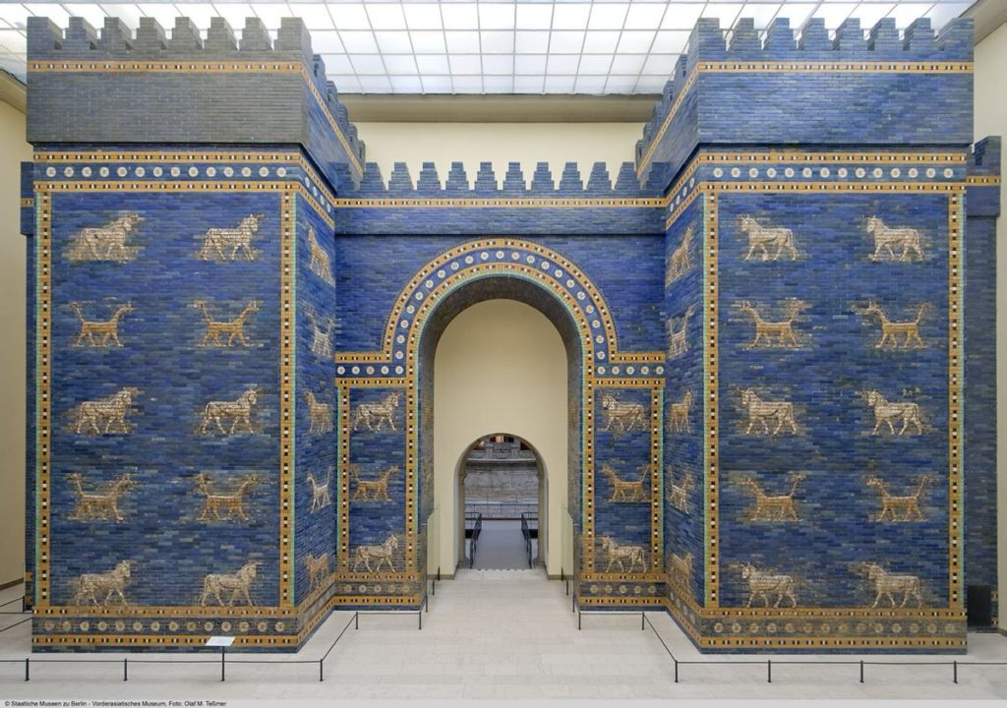
Ishtar
Gate
569 BC

Slide 9
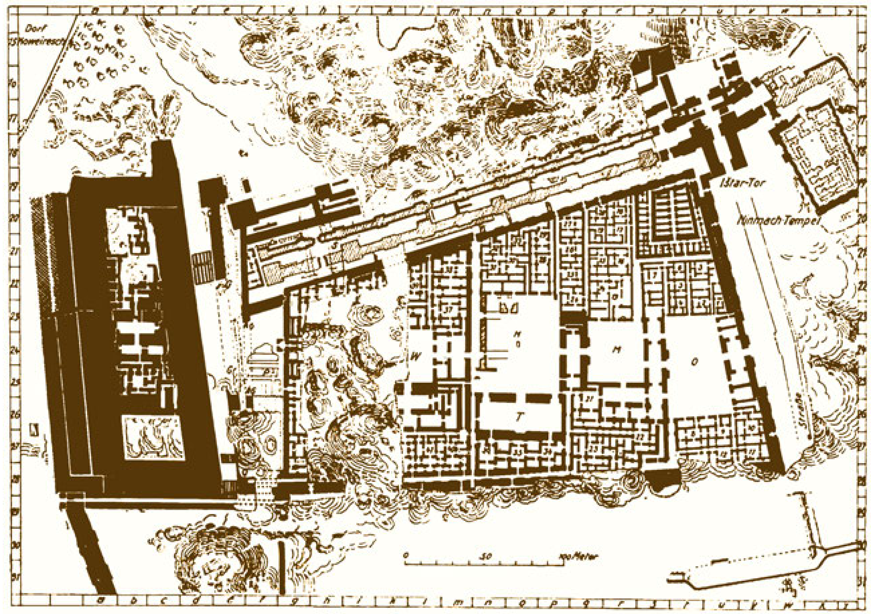
Palace of Nebuchadnezzar: Daniel 4:29

Slide 11
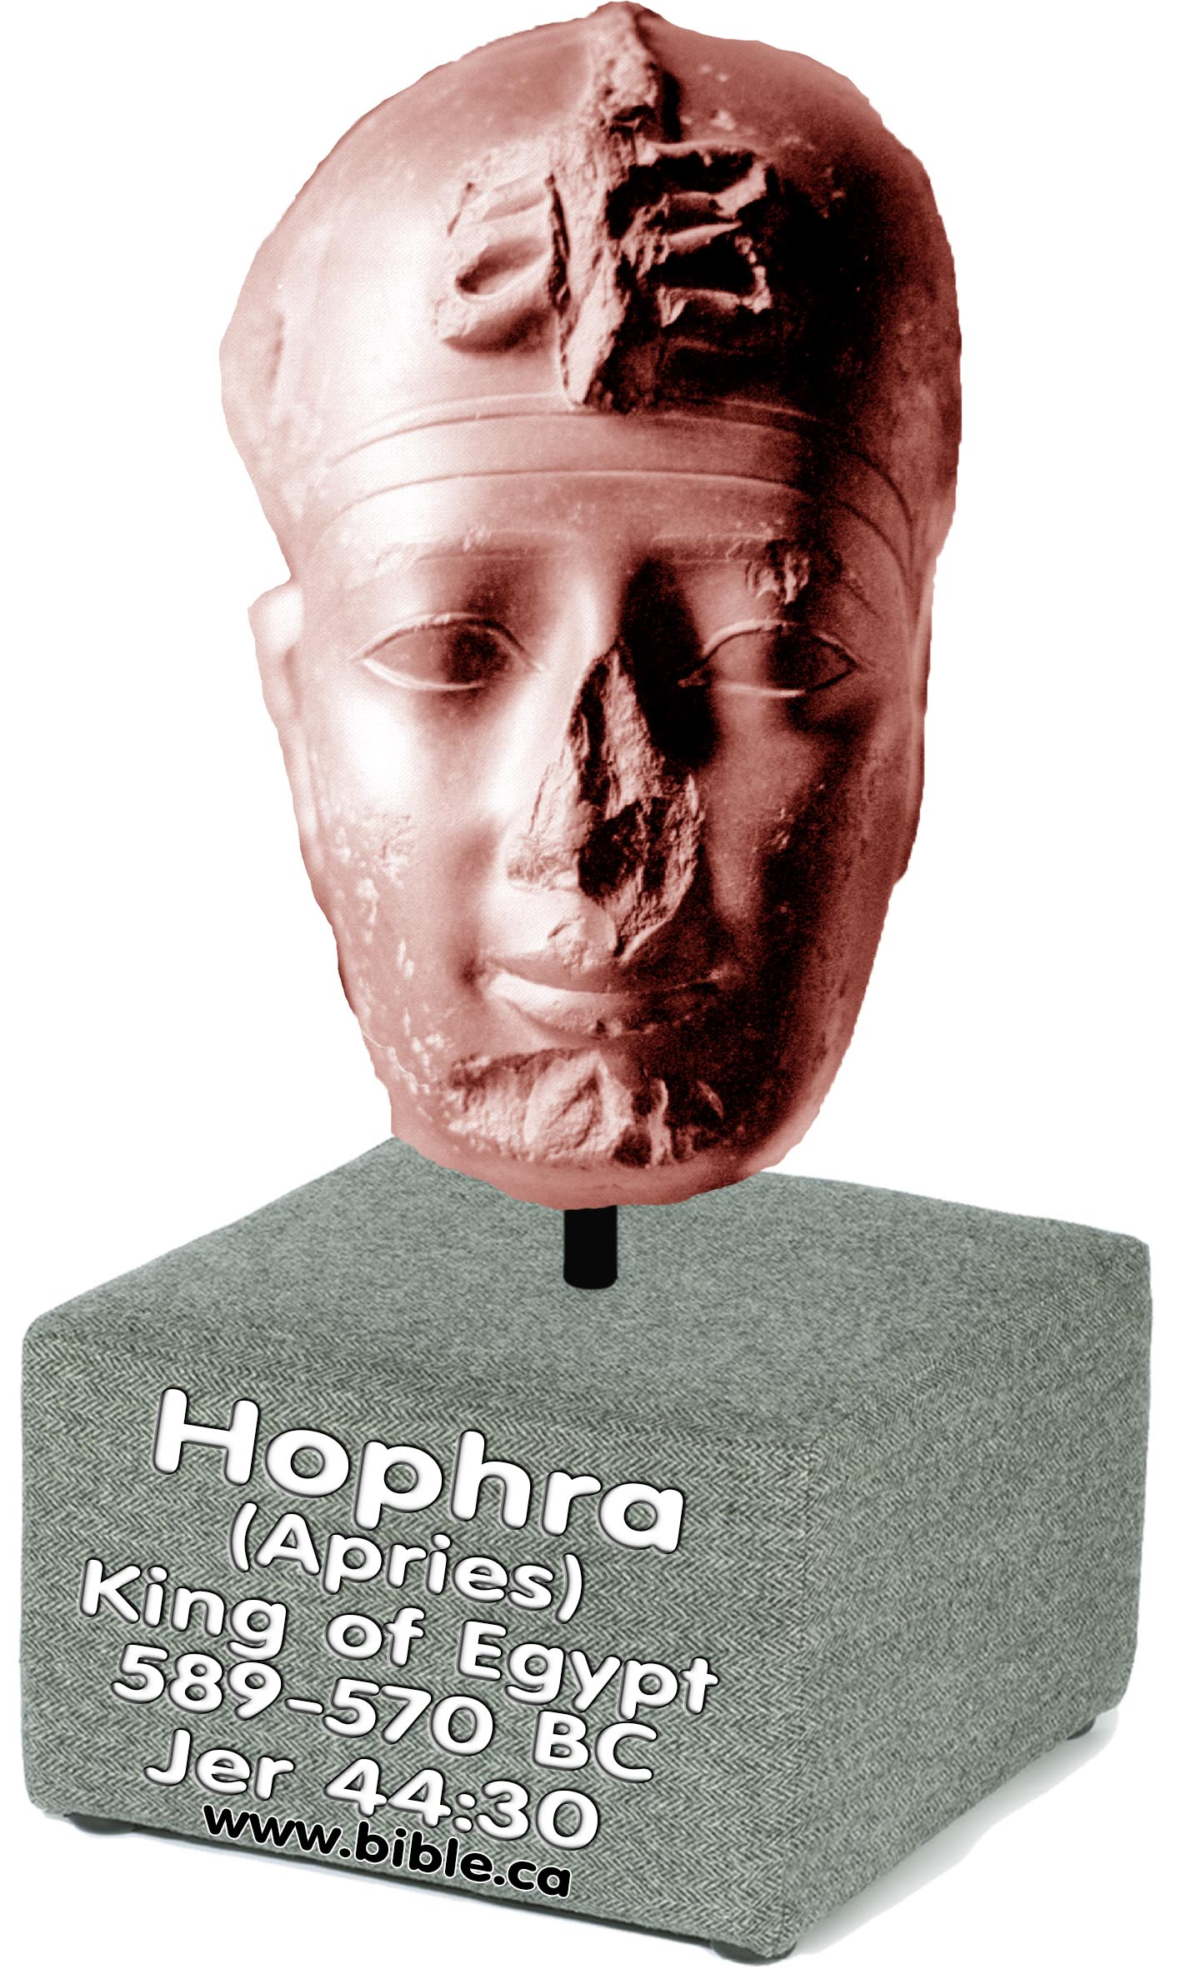
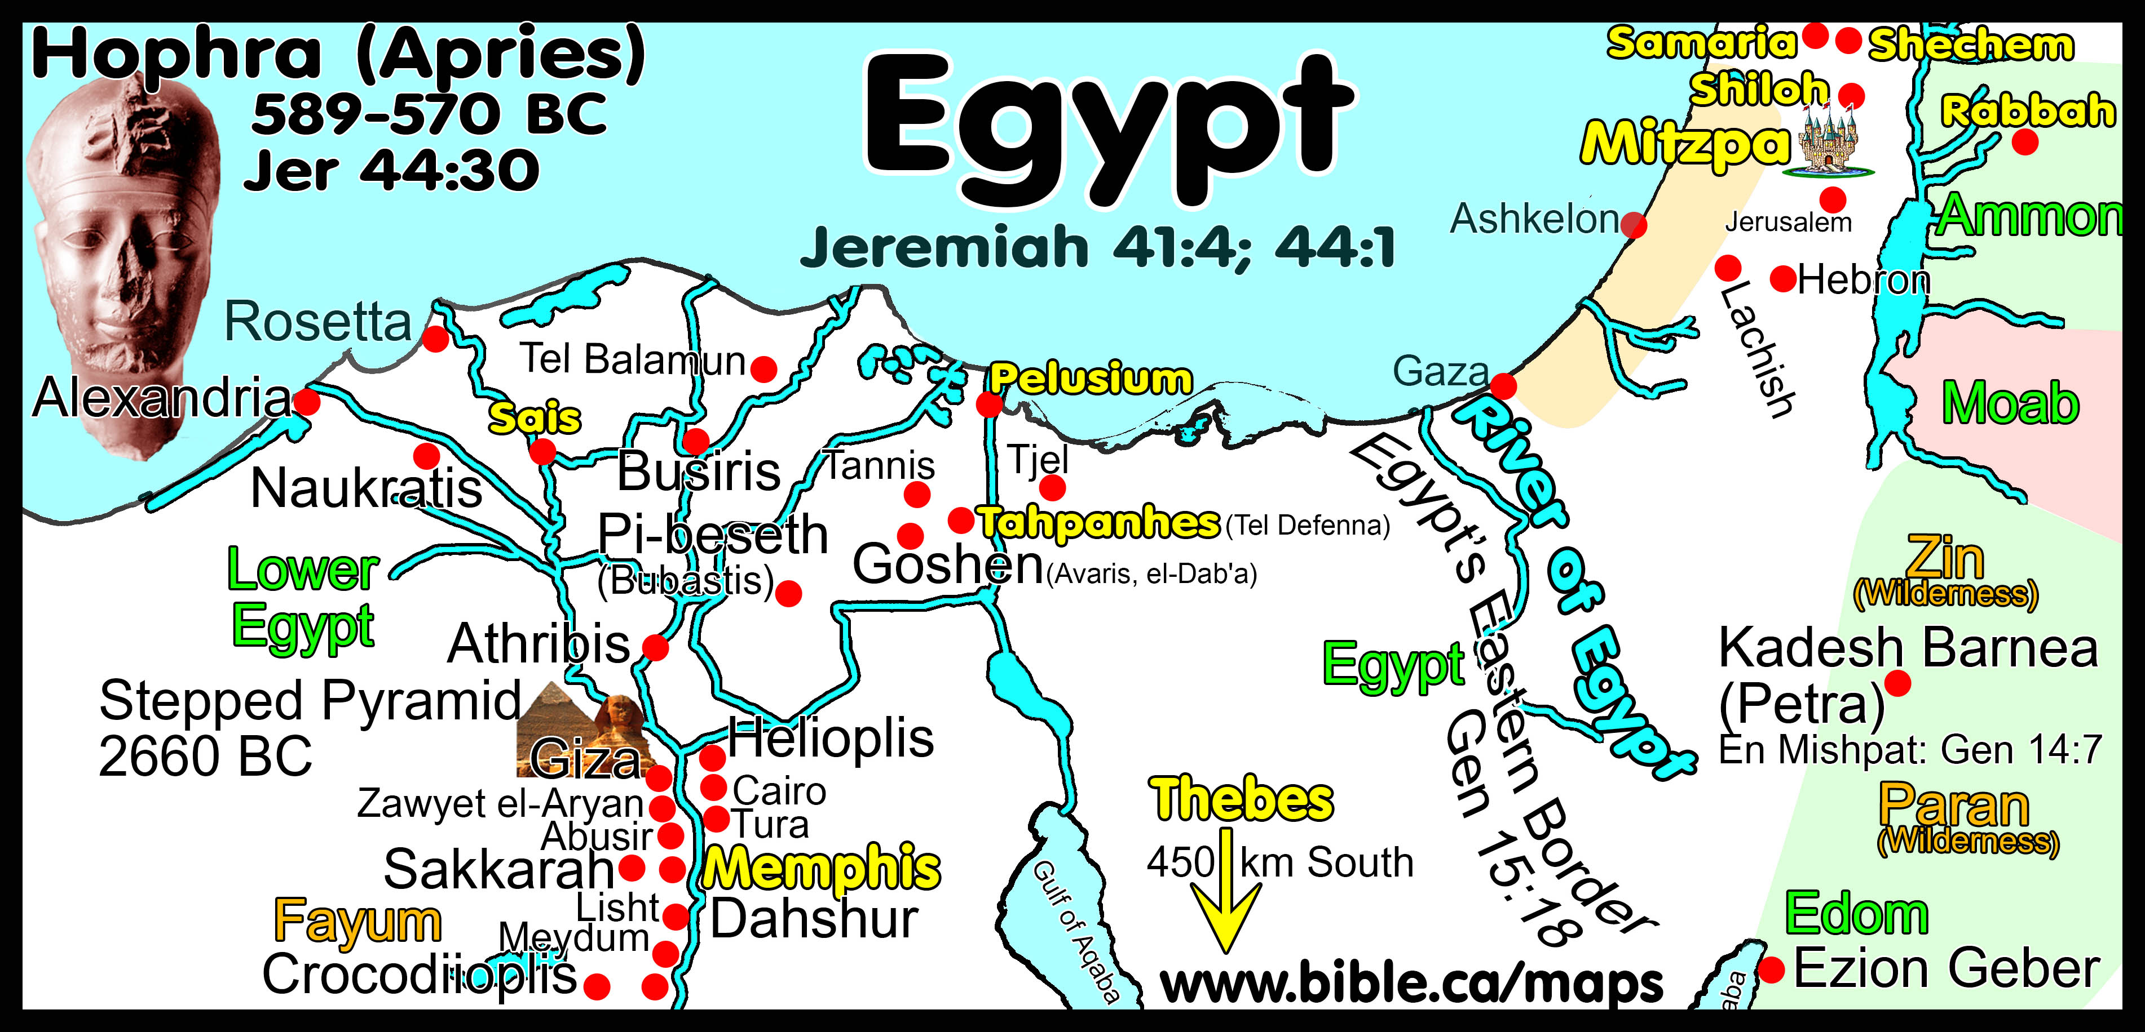
In 582 BC Nebuchadnezzar attacks Egypt and kills Jews living in Tahpanes fulfilling Jeremiah 44:30

Slide 21
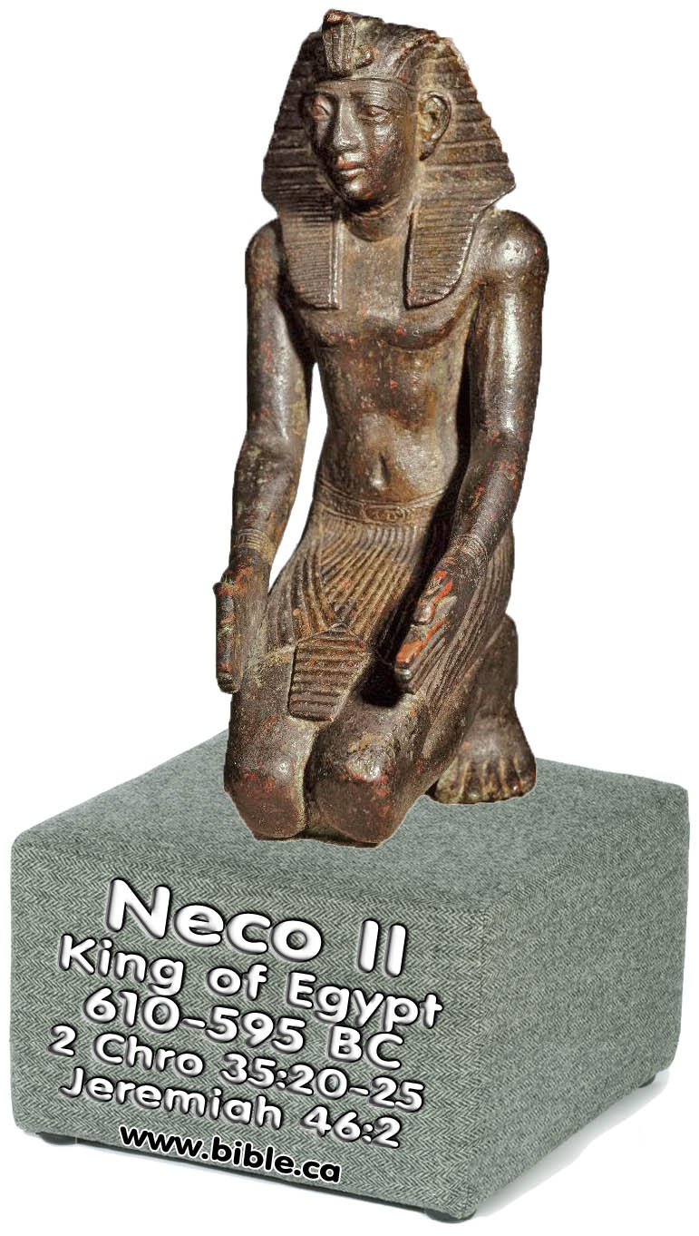
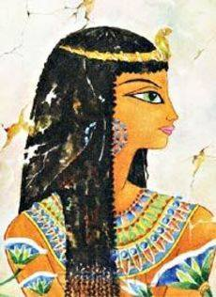
Pharaoh Necho II (664-610 BC)
609 BC: Pharaoh Necho II kills King Josiah at Megiddo: 2 Chron 35:20-27; 36:1-5; 2 Ki 23:28-37
605 BC: Nebuchadnezzar marries unknown daughter of Pharaoh Necho II as part of peace treaty. This wife is the mother of Nitocris (Egyptian name).
547 BC: Adda-guppi was the mother of Nabonidus who
died in 547 BC.
539 BC: Belshazzar dies: Handwriting on wall.
Nitocris is the granddaughter of Nebuchadnezzar
Nitocris is the granddaughter of Necho
Nitocris is the wife of Nabonidus
Nitocris is the mother of Belshazzar
Nitocris is the queen who knew Daniel: Dan 5:10

Slide 22
Nitocris was the queen mother who knew Daniel: Dan 5:10
Unnamed daughter of Pharaoh Necho.
Presumed to marry Neb. in 605 (2nd wife).
Nebuchadnezzar II.
Born ca. 642 BC.
Reigned 605-562 BC.
Egyptian détente 605.
Adda-guppi,
Nabo- nidus’s mother, 648-547 BC. Husband: Nabu-Balatsu-iabi
Nitocris (Herod-
otus 1:185-188).
Queen mother
of Daniel 5.
Nabonidus. Born
about 627 BC.
Reigned 556-539.
Belshazzar.
Coregent with his father, 553-539 BC.
This lineage of Raymond Dougherty, Nabonidus and Belshazzar (1929), explains why Belshazzar is called the son of Nebuchadnezzar 6 times in Daniel 5. It explains why Belshazzar’s mother, Nitocris, had an Egyptian name (Herodotus, Histories 1.188). It explains that Nitocris is the queen mother who told Belshazzar about Daniel the night he died.

Slide 27
Archaeology of Daniel
“Belshazzar Chief Official of the King”
Featured Glyptic Artifacts
Museum of Florence #135
Yale Babylonian Collection #3765
Amel-Marduk: 561 BC
Neriglissar: 560 BC

Slide 28
Daniel learned cuneiform: Dan 1:4
Florence #135 + Yale #3765.
Sofer collection 001 “Al-Yahuda” translated “city of the Jews”
Jehoiachin’s ration tablet of Amel-Marduk (561 BC, Jer 52:31-34)
Babylonian Chronicles, etc.

Slide 30
Daniel as the chief ruler
602 BC: 2nd ruler under Nebuchadnezzar: Dan 2:48; 5:7
573 BC: Daniel interprets vision in Daniel 4.
561 BC: Archaeological Museum of Florence #135:
“Belshazzar, chief officer of the king” (Amel-Marduk)
560 BC: Yale Babylonian Collection #3765:
“Belshazzar, chief officer of the king” (Neriglissar)
539 BC: 3rd ruler under Nabonidus and coregent Belshazzar: Dan 5:7
539 BC: 2nd ruler under Darius: Dan 6:3
536 BC: 2nd ruler under Cyrus: Dan 6:28

Slide 31
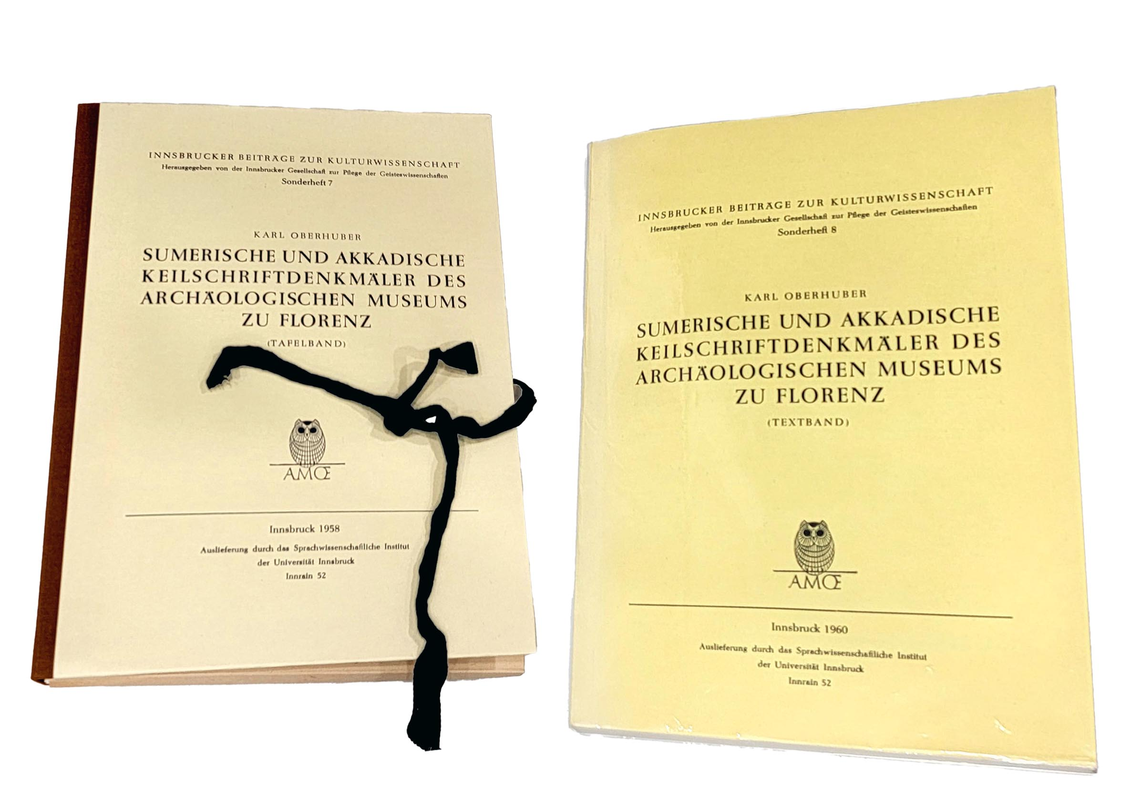
Museum of Florence
1958
1960

Slide 32
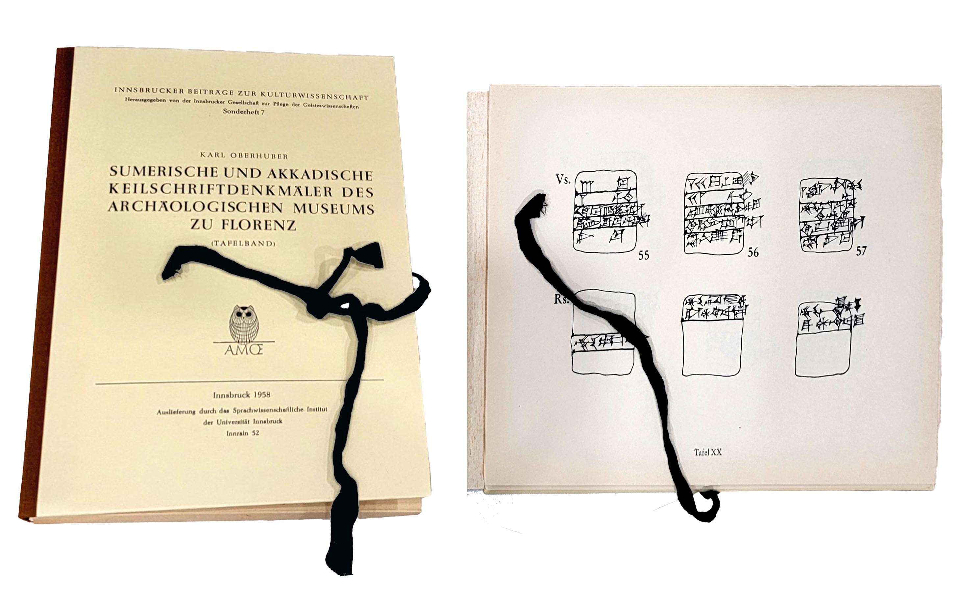
Museum of Florence
1958

Slide 33
Museum of Florence #135
King Amel-Marduk in 561 BC
Translation by Matt Glassman
Obverse
10 minas of silver
that Bel-šar-uṣur, the chief official of the king,
to Remut, his son, who ... ?
4)
Reverse
5)
6) the official of the king
7)
8) ... day 1, year 2 of
9) Amel-Marduk, the king of Babylon
[Amel-Marduk]
Sumerische und akkadische Keilschriftdenkmäler
des Archäologischen Museums zu Florenz,
Karl-Oberhuber, #135, 1958 AD

Slide 34
Yale Babylonian Collection #3765
King Neriglissar in 560 BC
Translation by Raymond Dougherty
“(As to) one mina (and) seventeen shekels of silver, which are in one shekel pieces, belonging to Belshazzar, the chief officer of the king, (charged) against Rimut, the son of Enlil-kidinnu, the silver which is from Nergal-danu, the son of Mukin-zer, for the road, what he gains upon it, half of the profit he shall share with Nergal-danu.” (Nabonidus and Belshazzar, Raymond Philip Dougherty, Yale Oriental Series Researches XV, YBC 3765, 560 BC accession year of Neriglissar, p68-69, 1929 AD)

Slide 35
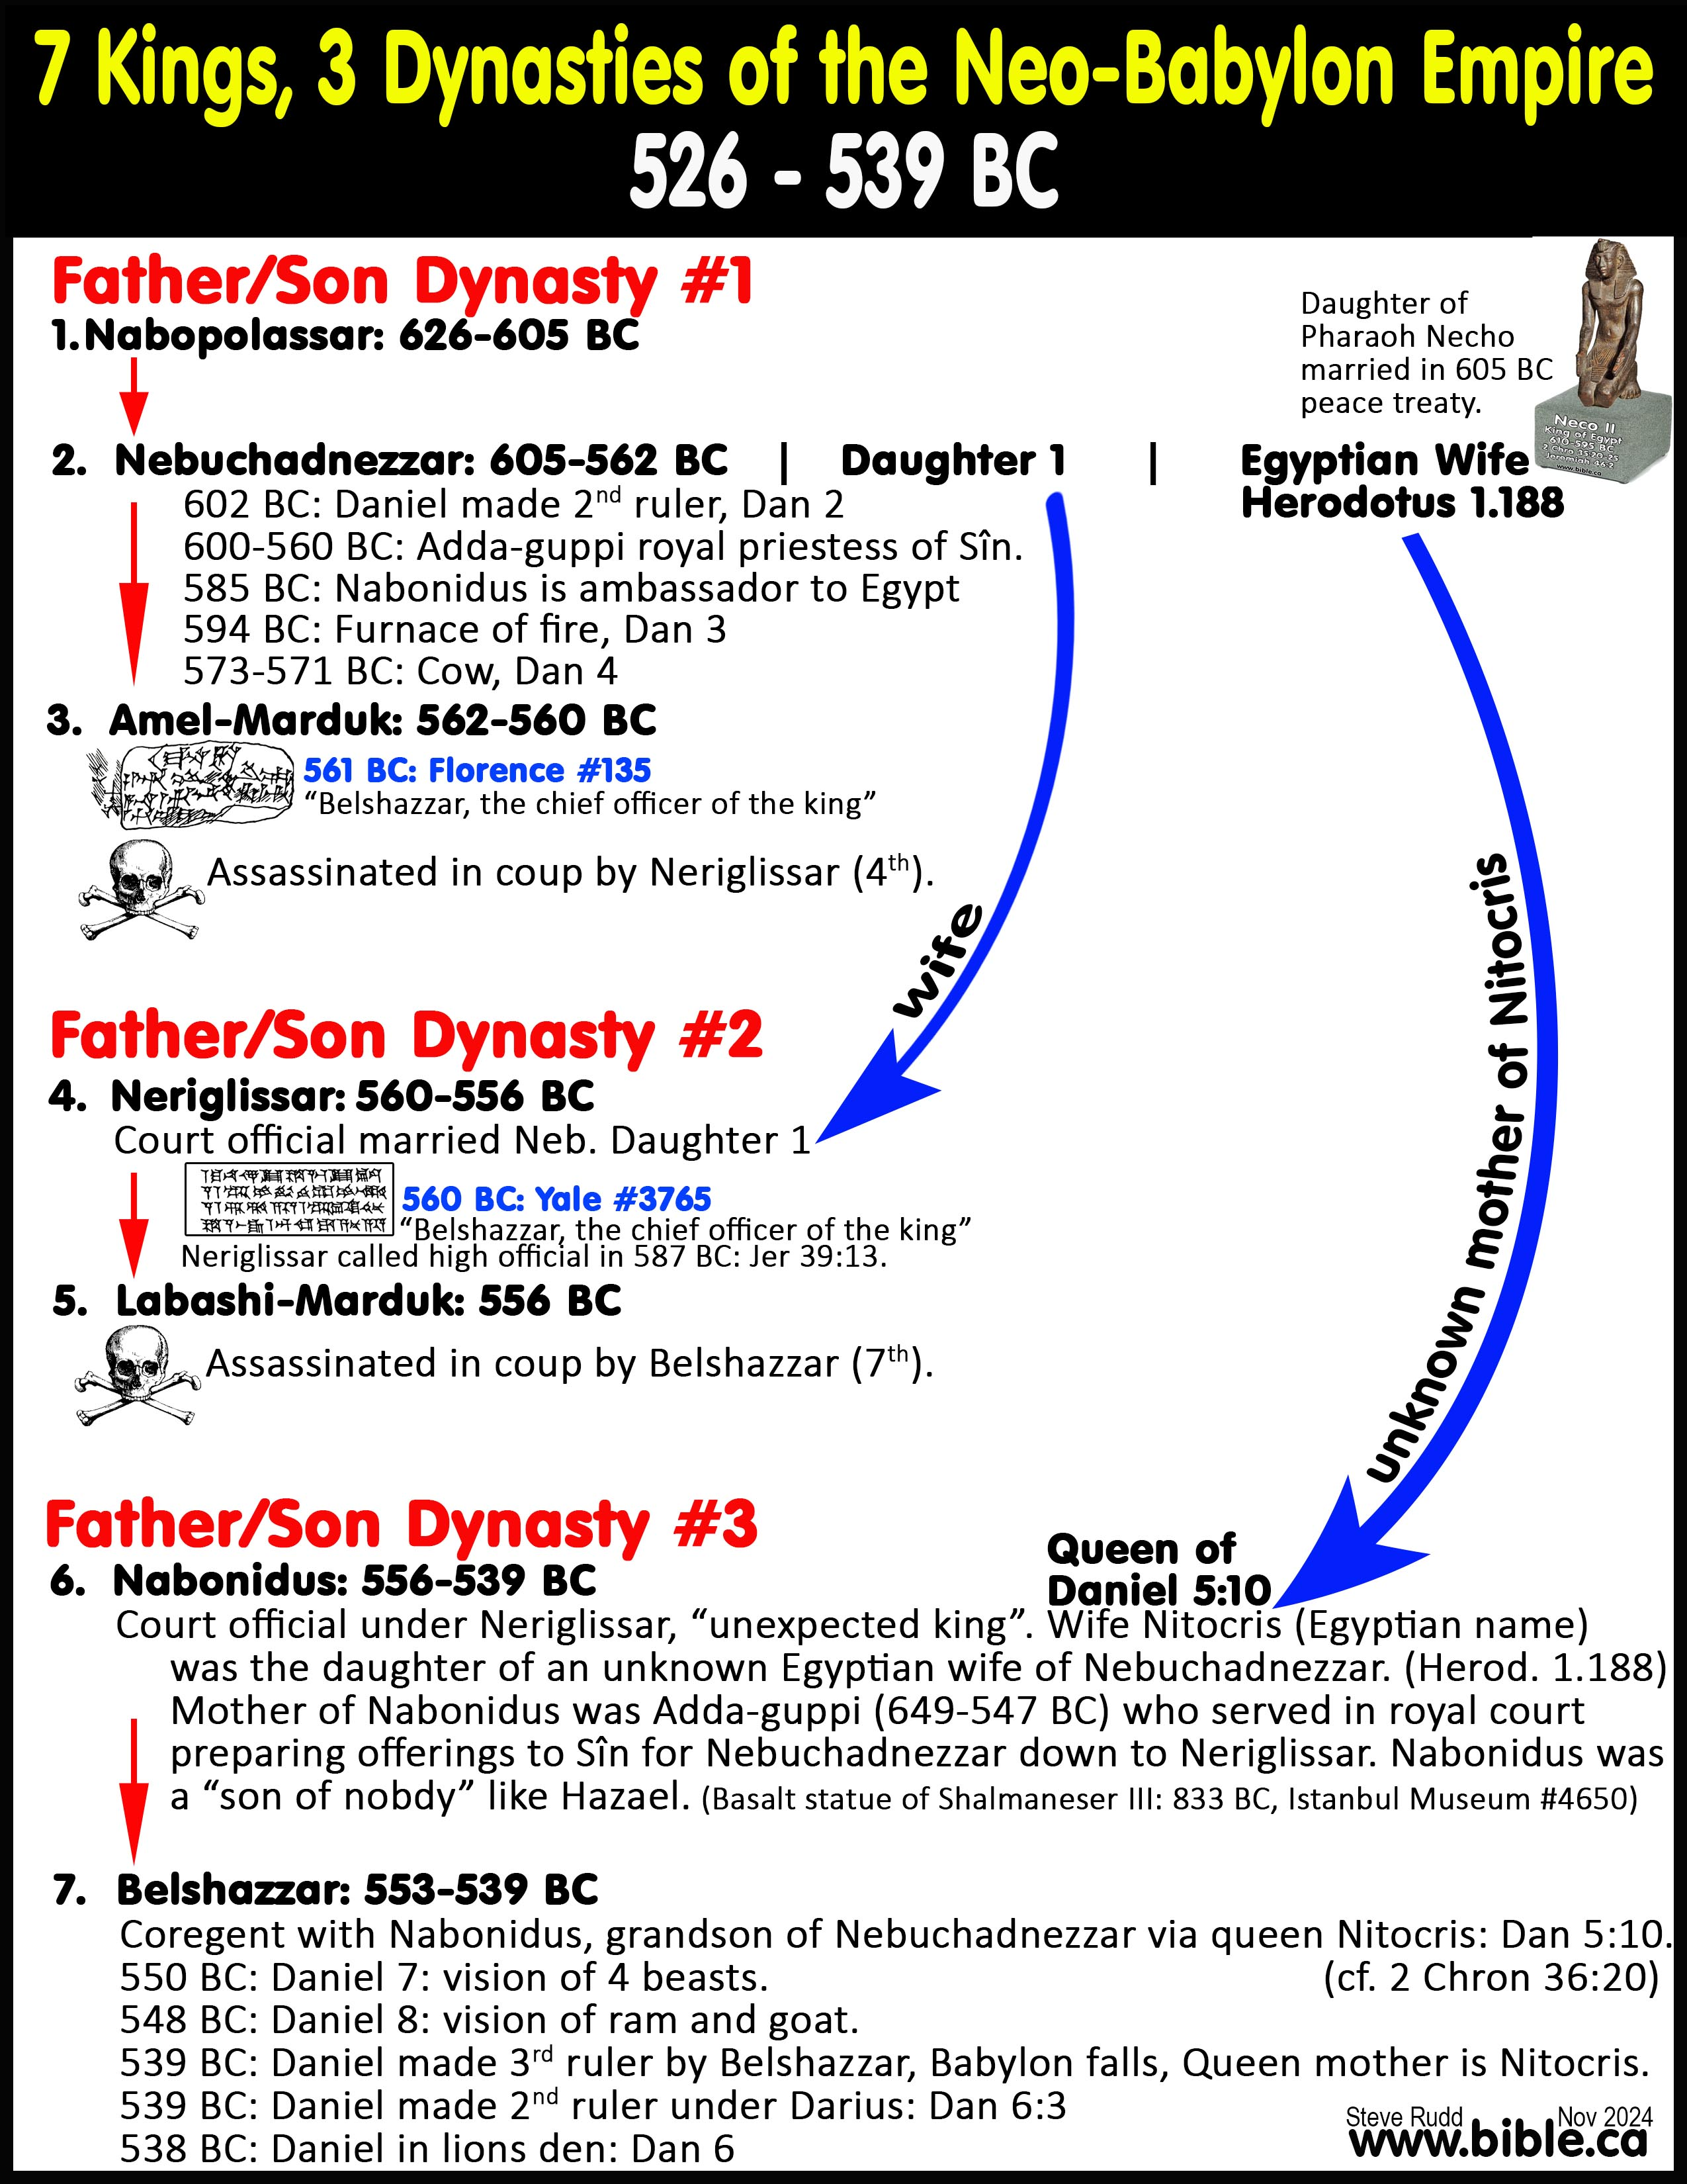

Slide 36
Florence #135
Amel-Marduk: 561 BC
Yale #3765
Neriglissar: 560 BC
Which Belshazzar: Daniel or the King?
Belshazzar had to be told about Daniel by his mother Nitocris (Dan 5:10) despite Daniel being active in 571 BC when Nebuchadnezzar was restored of his insanity (Daniel 4), which was only 10 years before Tablet Florence #135 in 561 BC.

Slide 37
Florence #135
Amel-Marduk: 561 BC
Yale #3765
Neriglissar: 560 BC
Which Belshazzar: Daniel or the King?
The father-son dynasty was disrupted twice by violent coups before Nabonidus (6th) became king, making it highly unlikely Belshazzar would be ever be appointed 2nd to Neriglissar.

Slide 38
Florence #135
Amel-Marduk: 561 BC
Yale #3765
Neriglissar: 560 BC
Which Belshazzar: Daniel or the King?
Nabonidus, like Hazael, was a usurper “son of nobody” outside the Royal bloodline, making it highly unlikely his son Belshazzar would ever be appointed 2nd to two kings.

Slide 40
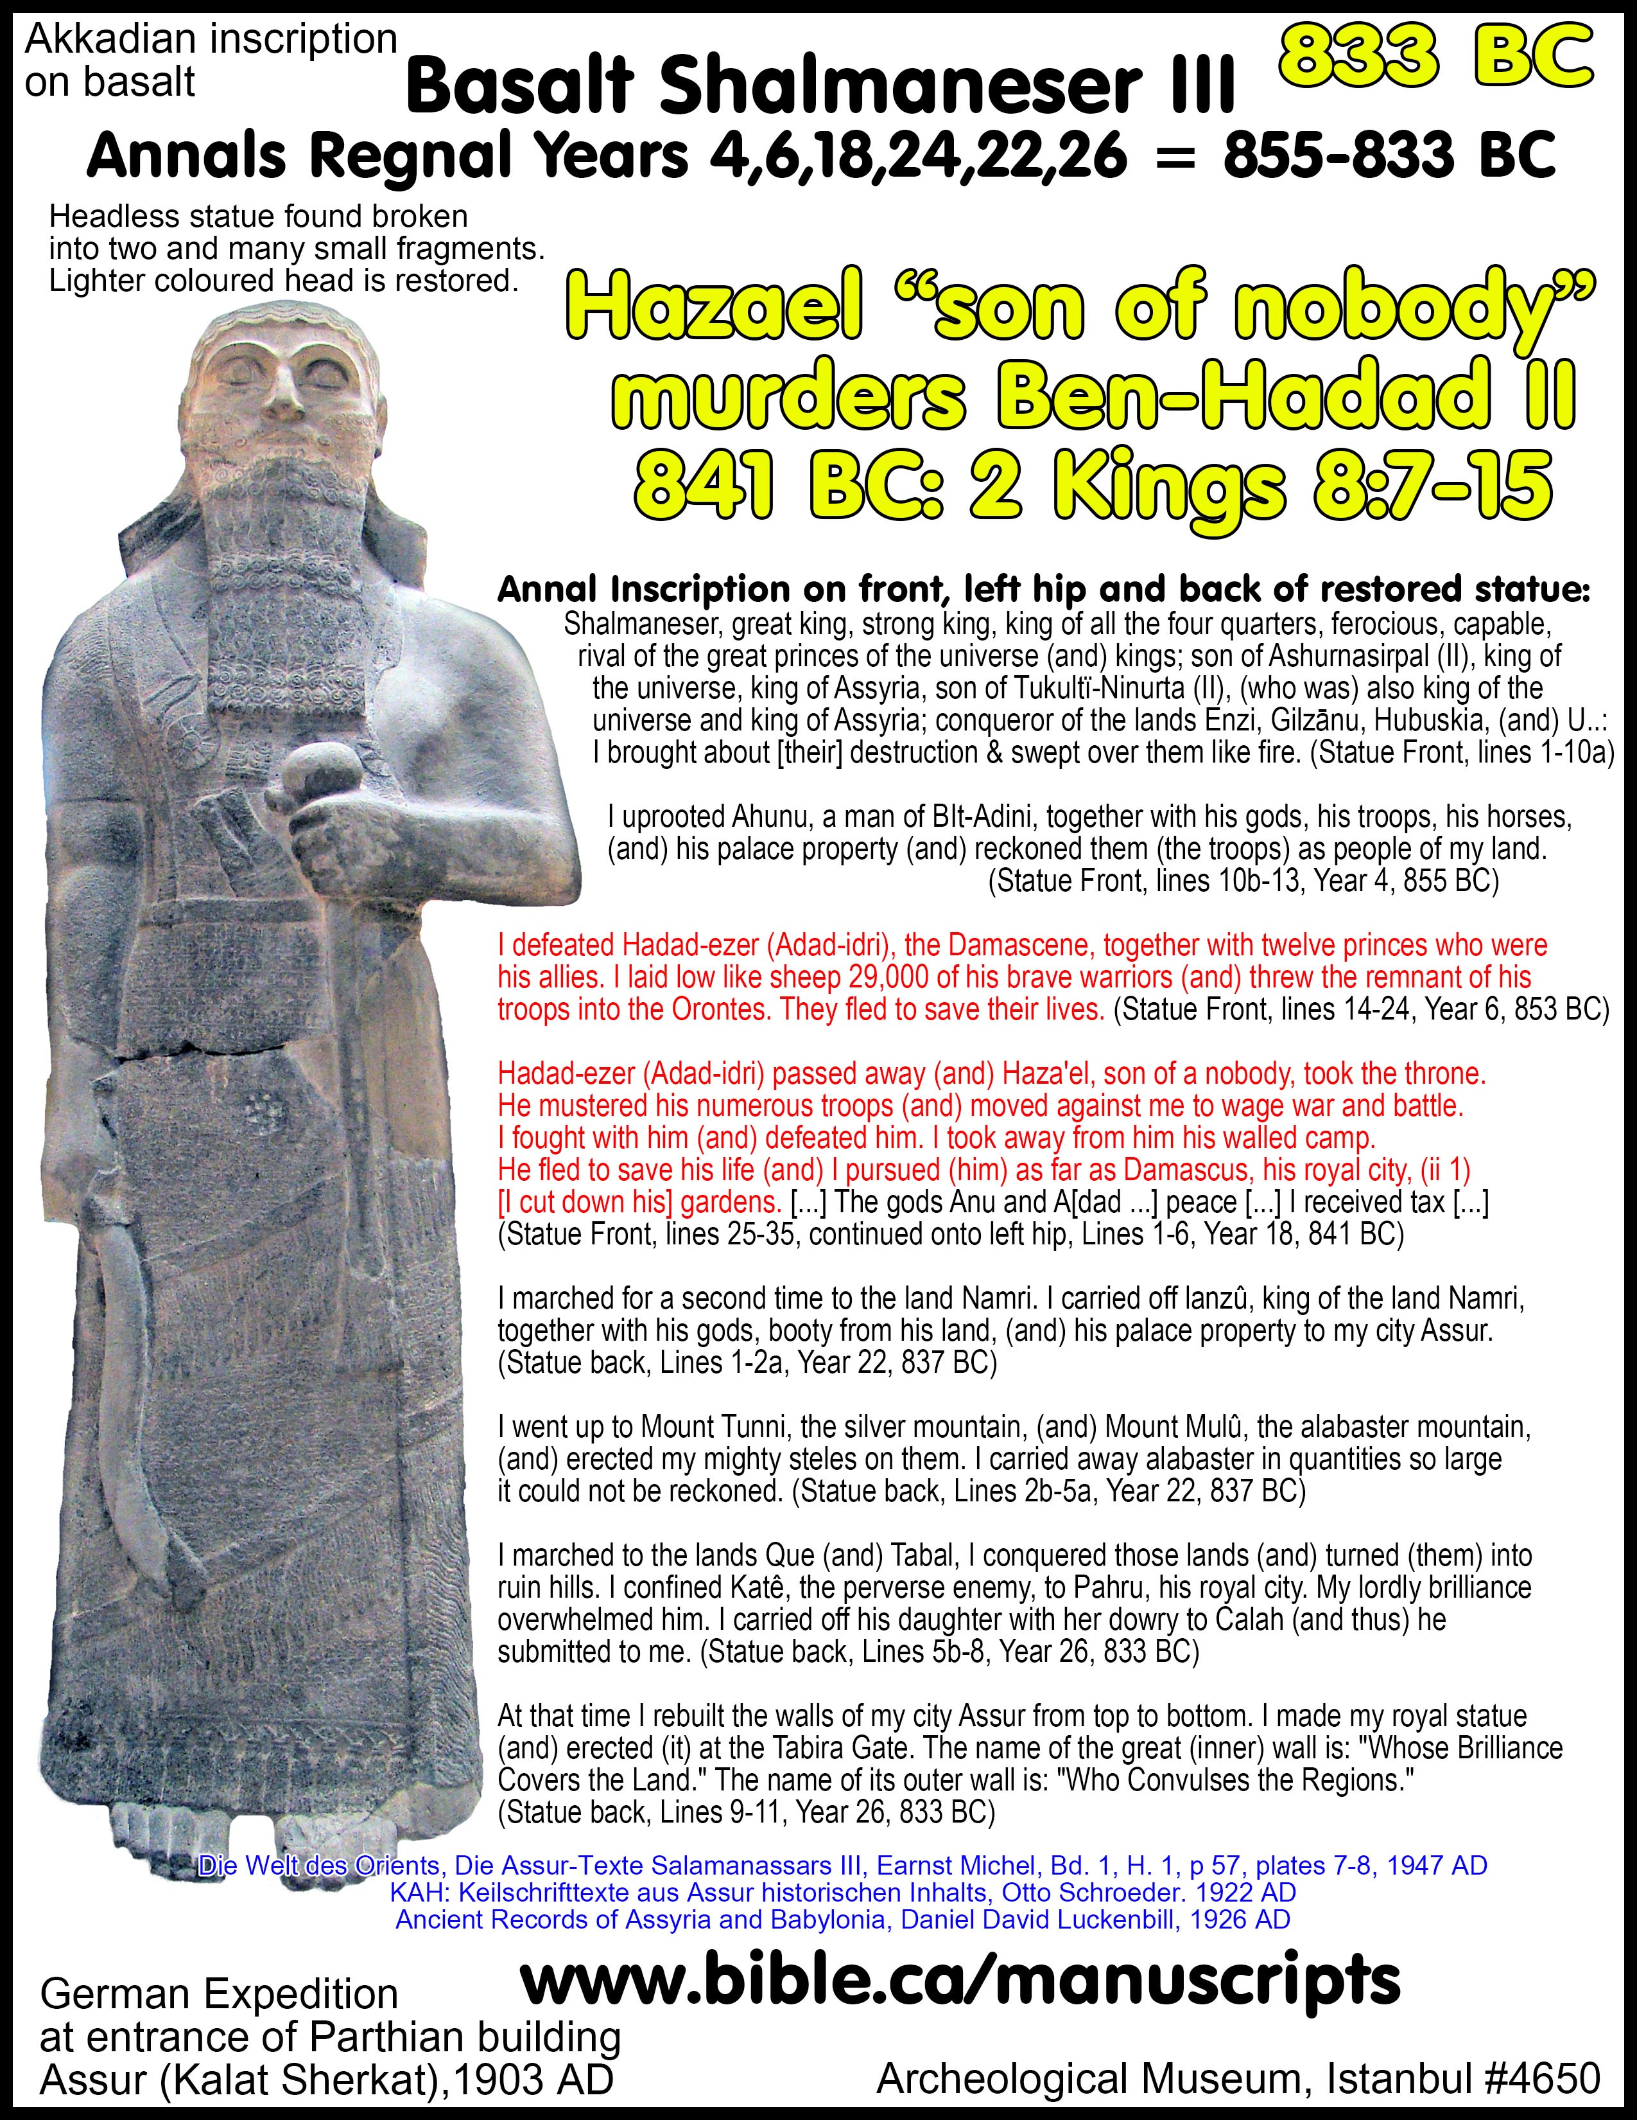
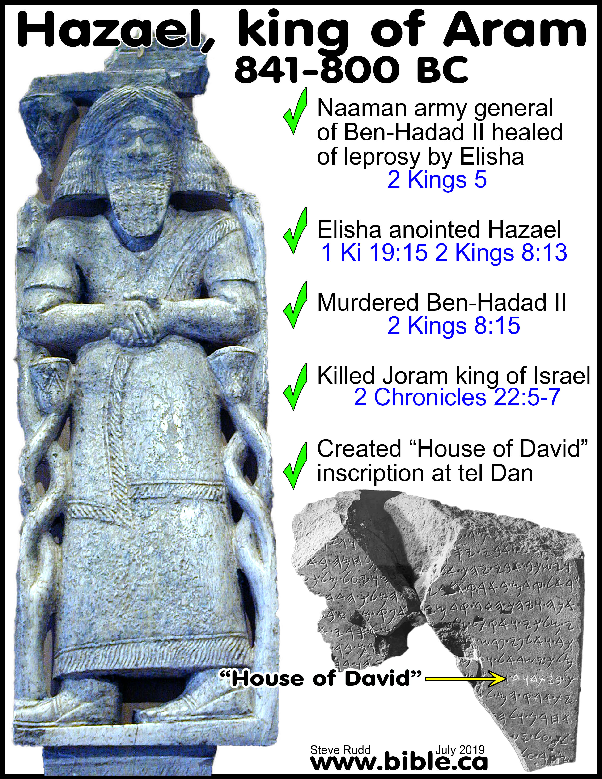

Slide 41
Florence #135
Amel-Marduk: 561 BC
Yale #3765
Neriglissar: 560 BC
Which Belshazzar: Daniel or the King?
In Tablet Florence #135 (561 BC), the most likely person who king Amel-Marduk (3rd) would appoint as chief official, excluding Daniel, would be his son (?), someone in the Royal family, possibly Ambassador Nabonidus, anybody but the obscure Belshazzar.

Slide 42
Florence #135
Amel-Marduk: 561 BC
Yale #3765
Neriglissar: 560 BC
Which Belshazzar: Daniel or the King?
In Tablet Yale #3765 (560 BC), the most likely person, excluding Daniel, who Neriglissar (4th) would appoint to be chief official would be his son Labashi-Marduk (5th) who succeed him, possibly Ambassador Nabonidus, but not Belshazzar.

Slide 43
Florence #135
Amel-Marduk: 561 BC
Yale #3765
Neriglissar: 560 BC
Which Belshazzar: Daniel or the King?
That Belshazzar was never foreseen to be in line with the throne argues in favor that he would be reappointed after the first coup, but this obscurity argues against him being appointed at all.

Slide 44
Florence #135
Amel-Marduk: 561 BC
Yale #3765
Neriglissar: 560 BC
Which Belshazzar: Daniel or the King?
Florence #135 and Yale #3765 (560 BC) are dated only 1 year apart, and must be the same person, even though succession was the result of a violent coup between the inscriptions. Only a neutral and trusted person outside the royal family like Jewish Daniel would be reappointed in his position after the coup by the new king.

Slide 45
Florence #135
Amel-Marduk: 561 BC
Yale #3765
Neriglissar: 560 BC
Which Belshazzar: Daniel or the King?
Adad-guppi (649-547 BC): In her “CV” (curriculum vitae), Adda-guppi brags that she introduced Nabonidus to serve three kings. Not only did Adda-guppi not brag that her grandson Belshazzar was “chief official of the king” under two of the same kings Nabonidus served, she totally ignores Belshazzar by never naming him.

Slide 47
Florence #135
Amel-Marduk: 561 BC
Yale #3765
Neriglissar: 560 BC
Which Belshazzar: Daniel or the King?
“One may still wonder how Belshazzar suddenly became such a prominent member of the oligarchy, especially as he is never mentioned in any private archive before the accession of his father.” (Paul-Alain Beaulieu, Reign of Nabonidus, p91, 1989 AD)

Slide 48
Florence #135
Amel-Marduk: 561 BC
Yale #3765
Neriglissar: 560 BC
Which Belshazzar: Daniel or the King?
Beltshazzar is a deliberate corruption of Belshazzar. "Daniel whose name is Belteshazzar according to name of a Babylonian god" (Dan 4:8) “Balat or Beltu” is a female Canaanite God, not Babylonian.
All four deliberately corrupted the spelling of their names
Daniel: Beltshazzar vs. Bel-shazzar "Bel/Marduk guard his life”
Hananiah: Shadrach vs. sudur-aku “Command of Aku/moon god”
Azariah: Abednego vs. Abed-nebo “Servant of Nebo"
Mishael: Michach vs. Miša-aku “Who is like Aku/moon god?”
Cf. Wm. Shea, “Daniel and His Friends in Babylon,” Archaeology and Biblical Research 4:2 (1991), pp. 57–64.

Slide 49
Florence #135
Amel-Marduk: 561 BC
Yale #3765
Neriglissar: 560 BC
Which Belshazzar: Daniel or the King?
Conclusion:
Titus Kennedy: “the evidence is certainly in favor of Daniel rather than Belshazzar son of Nabonidus.” (Discovery Institute, Dallas Science and Faith, Seminar video, 2023)
William Shea: “two extrabiblical references to Daniel by his original Babylonian name of Belshazzar have now been found”
(Bel(te)shazzar Meets Belshazzar, William Shea, Andrews University Seminary Studies, Vol. 26, No. 1, p77,81, 1988 AD)
Paul-Alain Beaulieu: “identity with Belshazzar (the king) seems unlikely.”
(Paul-Alain Beaulieu, Reign of Nabonidus, p99, fn23, 1989 AD)

Slide 50
Game Changer!
Florence #135
Amel-Marduk: 561 BC
Yale #3765
Neriglissar: 560 BC
Two earliest references to Daniel by 400 years
Silences Bible scoffers by dating daniel to 6th c. BC.

Slide 51
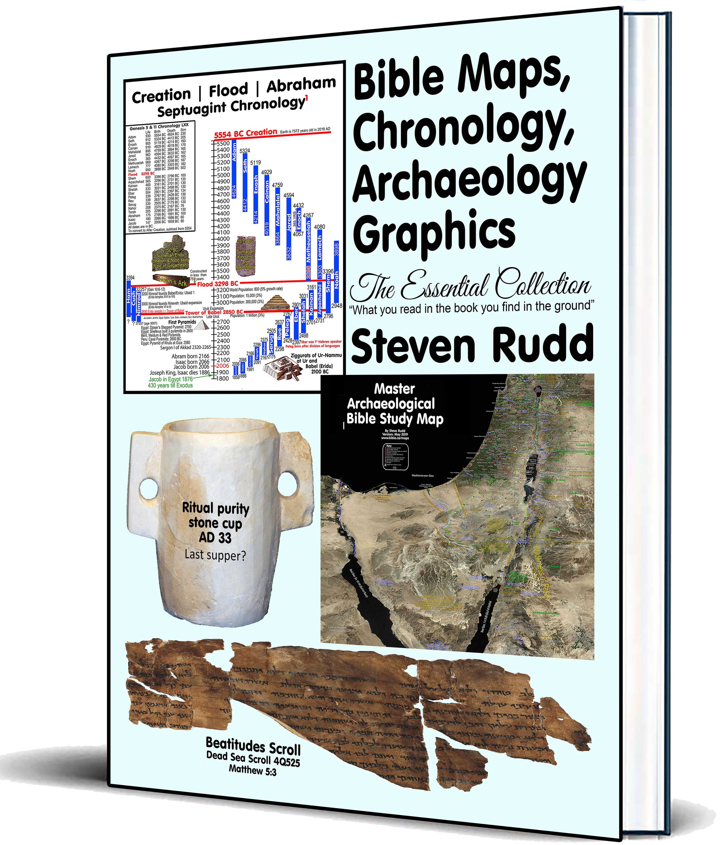
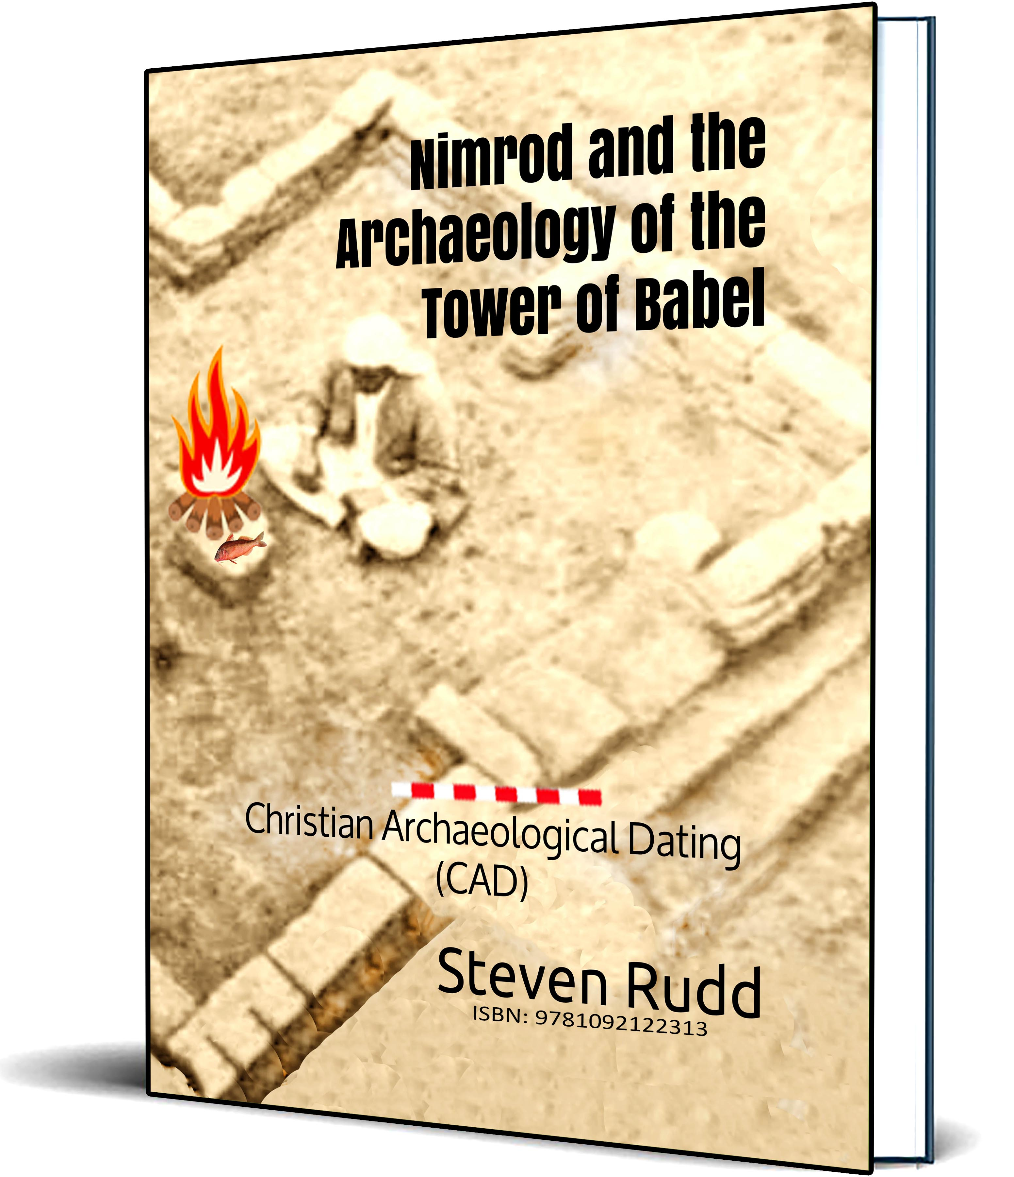
Books by Steven Rudd
Available on Amazon

Slide 52
Archaeology of Daniel
San Diego, Nov 2024
PowerPoint: www.Bible.ca/NEAS
Steven Rudd | Israel@bible.ca

